Slide 1

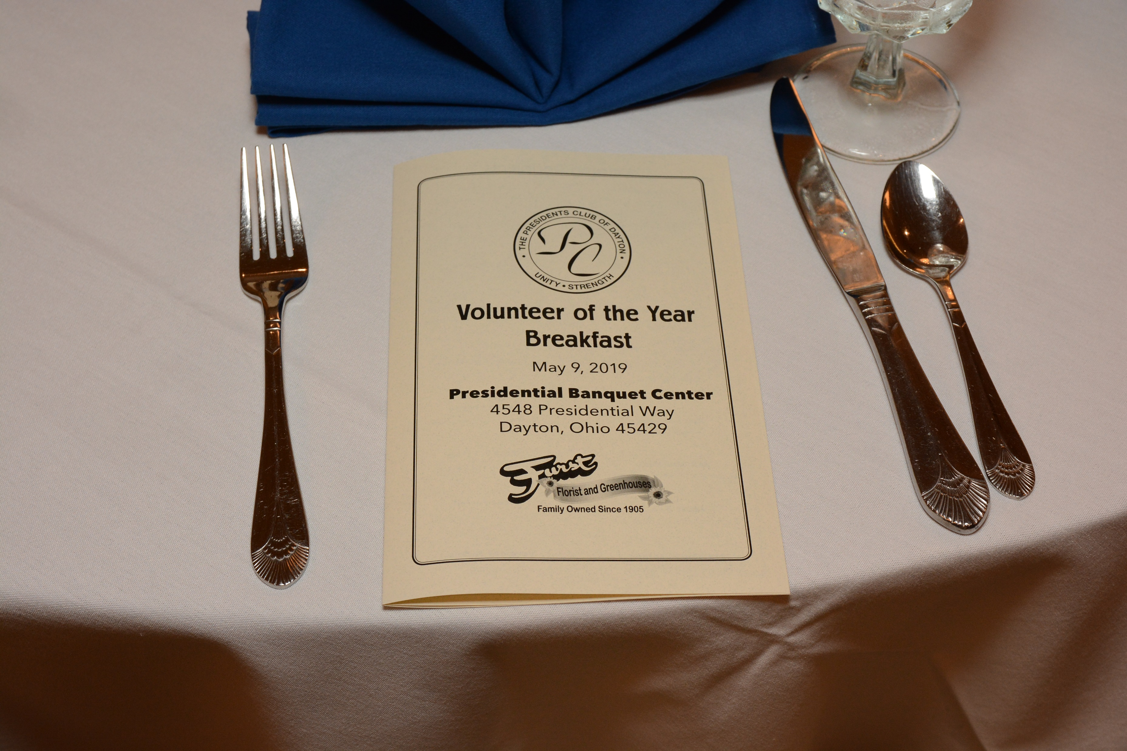
Presidents Club of Dayton
Outstanding Volunteers of the Year
August 12, 2021
Presidential Banquet Center

Slide 2
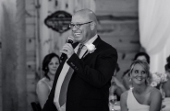
Steve Rudisill Executive Pastor
Christ United Methodist
Pastoral Ministry is a second career for Pastor Steve as he spent 20 years in sales prior to answering his call, predominantly at Johnson and Johnson in Pharmaceutical Sales. Steve strongly believes that the local church is still the greatest tool God uses to change the world. He is particularly passionate about the people who have had a bad church experience or have no church history at all and bringing them to know a life with Christ. He believes we have God given talents so that we can share them with others. His favorite saying is “We are blessed to be a blessing.” Steve is from the Dayton area and has been married to Tina since 1999. They are the proud parents of teenage sons Brady and Tate. Steve loves to perform music, is a huge super hero geek (prefers marvel) and is most happy if he is wherever his wife and kids are.

Slide 3
Master of Ceremonies Phil Parker

Slide 4

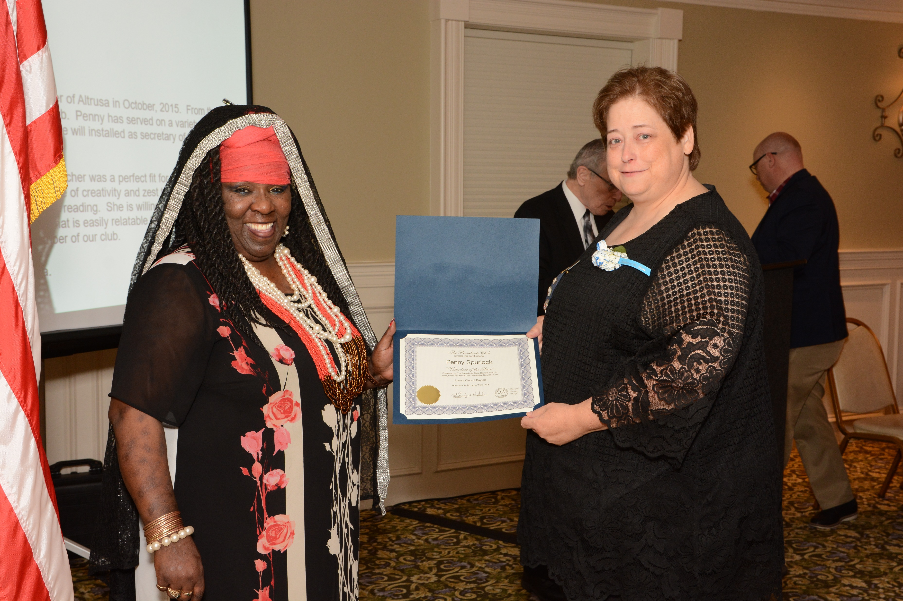
Altrusa Club
Recipient:
Reason for nomination:

Slide 5

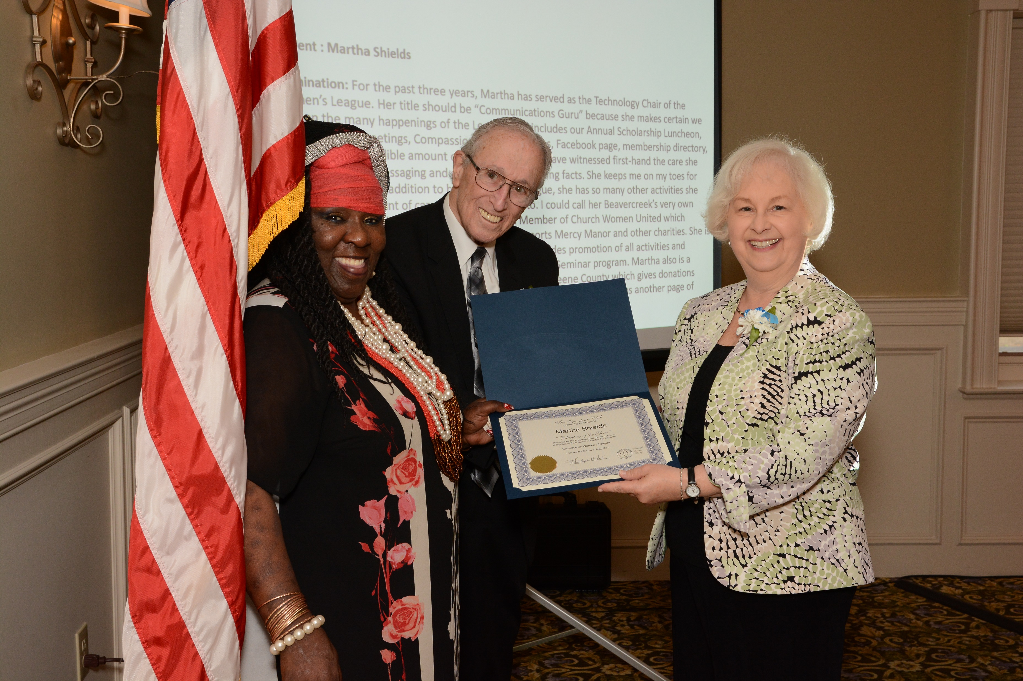
Name of Recipient :
Reason for nomination:

Slide 6
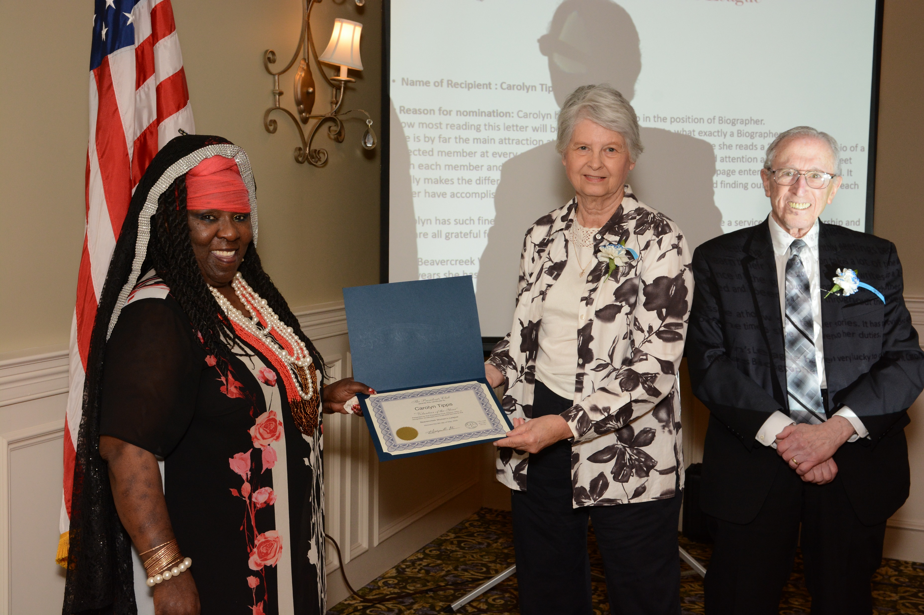
Name of Recipient :
Reason for nomination:

Slide 7

Civitan Club of Dayton
Name of Recipient: Al Harmon
Reason for nomination: Al Harmon has been the President of the Civitan Club of Dayton many times, too many to count. He is currently the club treasurer and the Governor of the Civitan Cardinal District. In addition to his many duties, he always finds time to pick up one of our Civitan Club member who no longer drives to our luncheons and gatherings.
Al Harmon can always be counted on to get things done when you need him to do a task. The Civitan Club really appreciates all the work that Mr. Harmon is doing to help our club achieve its many goals in the Dayton Community

Slide 8
Civitan Club of Dayton
Name of Recipient: Margaret Kruckemeyer
Reason for nomination: Margaret Kruckemeyer is involved in many organization’s in the Dayton Community. She is the Immediate Past President of the Dayton Woman’s Club and has helped in the remodeling effort where the Civitan Club has been going for the past three or four years for it’s luncheon meetings. She has helped the Civitan Club with it’s programs many times and has recruited new members. Ms. Kruckemeyer is a retired Military Nurse, and she is involved with many programs helping Veterans and her heart is helping others.

Slide 9

Dayton Arab American Forum
DAAF
Name of Recipient: Basel Yanes, MD
Reason for nomination: Dr Yanes is a Past President of The Dayton Arab American Forum and has worked behind the scenes for DAAF to raise money for Non-Profit organizations in the Dayton Community. He is a retired Oncologist and has served the community very well in saving lives. Dr Yanes served on more than a dozen community boards including Dayton art institute, Dayton visual art center and NCCJ (national conference of community and justice). Dr. Yanes is a proud Palestinian-American and is the Past president of the DBA Dayton Blood and Cancer Center in Dayton, Ohio. In the past, he served as the President of the Medical Oncology Hematology Associates. This is exemplified by his impressive contributions to the medical field and his Ohio community. Dr Yanes is an asset and leader to this community.

Slide 10
Dayton Arab American Forum
DAAF
Name of Recipient: Youssef Abdulaziz Elzein
Reason for nomination: Mr. Elzein has been a real tiger in getting things accomplished. In 2019, he ran for Mad River School Board to make a difference for kids. He is a Board member of the Dayton Arab American Forum (DAAF). His most recent accomplishment was working tirelessly with the City of Dayton to establish, Dayton Salfit Sister City in Palestine. This was recently accomplished after many hours, days and meetings working on this. He is a Board Member for the American Red Cross Dayton Chapter, and a Disaster Relief Emergency Services Member, a Past Builder for Habitat for Humanity and a volunteer for Catholic Social Services of Miami Valley to help Refugee Resettlement in the Dayton area. He is also on the Parent Leadership Council at the University of Dayton.

Slide 11

EXCHANGE CLUB of DAYTON
Name of Recipient:
Reason for nomination:

Slide 12
EXCHANGE CLUB of DAYTON
Name of Recipient:
Reason for nomination:

Slide 13

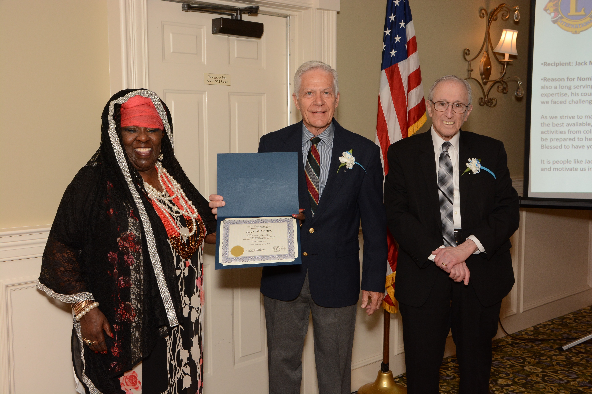
Lions - Dayton Club
Recipient:
Reason for Nomination:

Slide 14
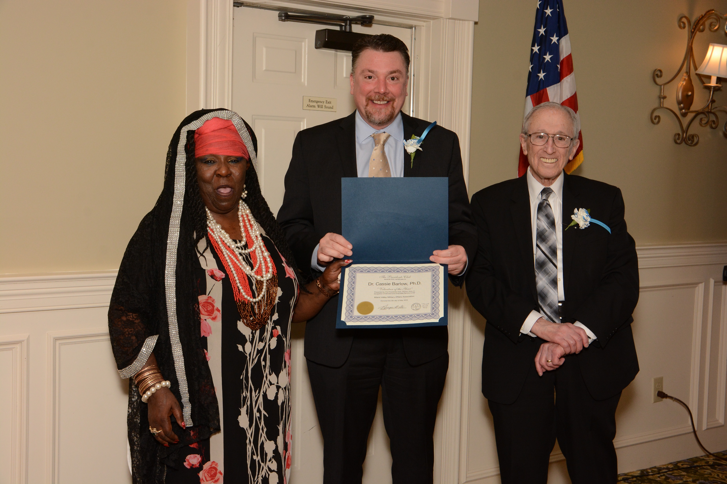
Miami Valley Military Affairs Association MVMAA
Recipient:
Reason for nomination:

Slide 15

Miami Valley Military History Museum
Recipient: Catherine I Beers-Conrad:
Reason for nomination: Catherine is heavily involved in providing direct support to the Veteran patients and their families at the VA Medical Center; she arranges monthly birthday parties in the Memory Care unit and dialysis and rehabilitation wards, Halloween parties for the mental health clinic, and Thanksgiving and Christmas Eve dinners at the Community Living Center and Hospice. Additonaly, she volunteers for the Disabled American Veterans as one of the Intensive Care Unit's receptionists. She is also a “No Veteran Dies Alone” volunteer at the Hospice.
Catherine's true passion is ensuring our Vietnam Veterans are thanked for their service and get the “Welcome Home” they were denied 50 years ago; her father was Killed In Action in 1969 when she was 8. In his memory, to date she's presented over 2,500 Vietnam War Veteran lapel pins in conjunction with the Department of Defense 50th Anniversary of Vietnam Commemoration Program.

Slide 16
Miami Valley Military History Museum
Recipient: Brent L. Davidson:
Reason for Nomination: Brent is active in various Veterans organizations such as the Veterans of Foreign Wars Auxiliary and is the Commander for Disabled American Veterans of America Auxiliary Unit 9. He is the Museum's Chaplain and serves as the Chaplain for the Department of Ohio Sons of Union Veterans of the Civil War. Brent has spearheaded a Memorial Day program honoring Native American Veterans; he also maintains memorials at the Dayton National Cemetery and other sites in the area; each quarter, he replaces the Medal of Honor flags on the 5 recipients' graves.
Each month he takes part in cleaning and maintaining the graves at Old Greencastle Cemetery a Brent has amassed more than 7,000 volunteer hours at the Dayton VA Medical Center. He volunteers for the annual Patriot Freedom Festival as well as numerous programs in the VA Nursing Home and Hospice.

Slide 17

Optimist – The Greene Club
Recipient:
Reason for nomination:

Slide 18
Optimist – The Greene Club
Recipient:
Reason for nomination:

Slide 19

Optimist – Centerville Noon Club
Recipient: Greg Fay
Reason for nomination:

Slide 20
Optimist - Centerville Noon Club
Recipient: Diane Arehart
Reason for nomination:

Slide 21

Optimist – Dor-Wood Club
Recipient:
Reason for nomination:

Slide 22
Optimist - Riverdale Club
Recipient:
Reason for nomination:

Slide 23
Optimist - Riverdale Club
Recipient: Barbara Layne
Reason for nomination:

Slide 24

Rotary Club of Dayton
Recipient:
Reason for nomination:

Slide 25
Rotary Club of Dayton
Recipient:
Reason for nomination:

Slide 26

Twentig, Incorporated
Recipient: Vurniece Jackson
Reason for Nomination.

Slide 27
Presidents Club Schedule
The Bob Chiles Golf Classic May 5th, 2022, location will be Beavercreek Golf Club
Monthly Lunches at the Masonic Temple Lower Level 11:30 AM
August 18th
September 15th
October 20th
November 17th
December 15th
The Citizens Legion of Honor Award October 7th, 2021 at the Dayton Convention Center

