Slide 1

Presidents Club of Dayton
Best Member Award Breakfast
May 14, 2015
Presidential Banquet Center

Slide 2
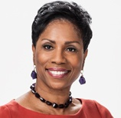
Master of Ceremonies Marsha Bonhart
Marsha Bonhart has been a fixture not only on television in the Dayton region but also the many causes she proudly serves.
Marsha started her career in Dayton in 1980 after working at WHDO-TV and WMHE-FM Radio in Toledo, her hometown.
She spent time reporting and anchoring at KTTV-TV in Los Angeles, WKEF-TV here in Dayton and most recently at WDTN-TV, which she joined in 1988.
A frequent emcee at community events, Marcia “Crack Addicted Babies” was nominated for an Emmy. She won the Ohio Public Images Award in 1993 and 2004 for producing stories about people with developmental disabilities.
She was selected as one of the Dayton Daily News’ Ten Top Women in 2003 and has earned the YWCA Award for Personal Achievement and Community Involvement as well as “Top 15 Friends” award from Artemis Center for Alternatives to Domestic Violence and was named a YWCA Dayton “Woman of Influence” in 2009. This spring, Marsha received the lifetime achievement award from YWCA DAYTON.
Marsha’s greatest work, however, has been raising her two sons Chip and Robbie.

Slide 3

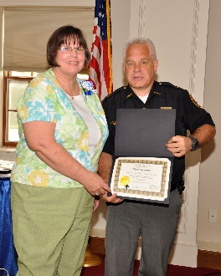
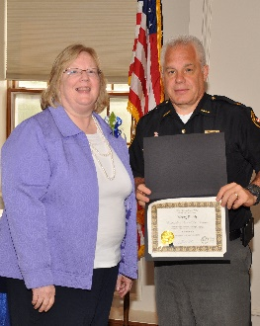
Altrusa Club
Recipient: Diane Noonan
Reason for nomination: When Diane joined Altrusa three years ago, she hit the ground running. She took on two major club projects, the club newsletter and the membership directory and she was successful in running both of these important publications. Diane also helped with other club projects right from the start, at Cleveland School, the Widows Home and the Club Auction. In January, Diane led the club project of cooking a meal for the guests of the Ronald McDonald House. Diane continues to be an asset to the Altrusa Club in many ways.
Recipient: Mary Reed
Reason for nomination: Mary has been a member of Altrusa for six years even with her Dayton Public School job, she finds time to put Altrusa service into her schedule. Mary was the lead person for two projects that were conducted with her kindergarten and the first grade classes. Mary served as the co-chair of the club’s membership committee and now serves on the communications committee. Altrusa is fortunate to have Mary as an active member.

Slide 4

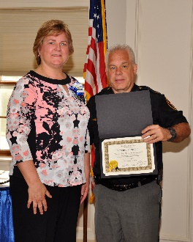
Centerville Lions Club
Recipient: Roberta Thornhill
Reason for nomination: Roberta Thornhill, “Robbie”, joined the Centerville Lions club on 9/1/2005. She is the immediate past President, current 1st Vice President and membership chair. She is very dedicated to her club and providing services to those in need. During her time as president, she increased the membership and added new activities and fund raisers. During her presidency, the annual 5k run/walk was developed and continues to grow and improve every year. This will be the fourth anniversary for this event. She participates in all club activities.

Slide 5
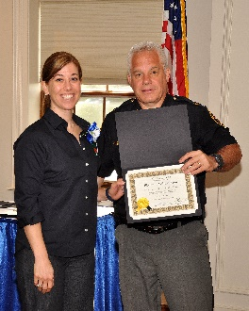
Dayton Lions Club
Recipient: Shannon Schweitzer
Reason for nomination: Shannon has great leadership skills. 12 years director of Lions Eye Bank of West Central Ohio. Great recruiter of Lions Club New Members. Four new members to date. Enthusiastic, and positive in all her responsibilities. Excellent interpersonal skills. A great young woman. We are proud to have her in our club.

Slide 6

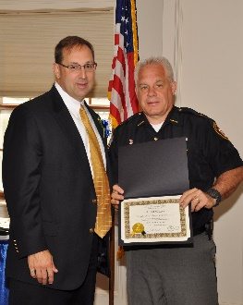
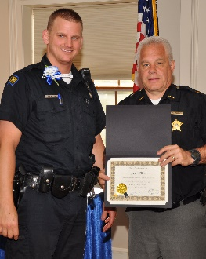
Civitan Club of Dayton
Name of Recipient : Brian Miller
Reason for nomination: Brian is currently the CEO of Mach 4 and Senior Tech Connections. He is an accomplished executive and entrepreneur with 20+ years of experience in technology and telecommunication industries. He has been a vital and valued member of the Dayton Civitan club since 2008. He is a past two term club president who leads by example with his courage, integrity and his drive to help others. Brian has never ignored the call to serve. He demonstrates it daily though his support of Civitan, the American Heart Association, Hero’s Fund, and the Wounded Warrior project. The Dayton Civitan club is very fortunate to call him one of our own.
Name of Recipient : Dayton City Police Officer Justin Ellis
Reason for nomination: Officer Justin Ellis of the Dayton Police Department displayed outstanding community orientated behavior by going beyond the duties of a police officer. While taking a theft report of a blind volunteer member of a Dayton church, he felt the need to help this person in need by getting help from the community and other police officers to replace the income that was stolen from the blind volunteer member. He was able to replace the income that was lost plus some additional funding. His self-less action was portrayed in the local news.

Slide 7

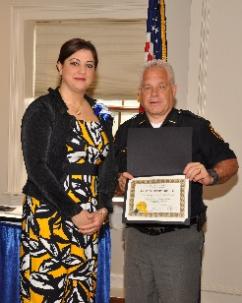
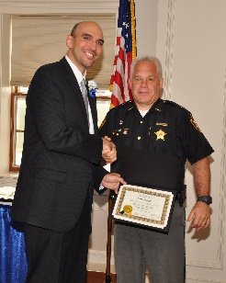
Dayton Arab American Forum
Name of Recipient: Dr. Pat Abboud
Reason for nomination: Dr Pat Abboud is a pediatric doctor at Dayton Children’s and part of the Dr. Mom Squad – an award winning blog focused on educating the community. As a volunteer, Dr. Abboud has raised over $90,000 individually for the Leukemia & Lymphoma Society (LLS) and was named Woman of the Year for LLS in 2012. Remaining active with LLS, she has chaired the Dayton Campaign for the last 2 years. Dr. Abboud also spends time educating children about the negative effects of drugs and alcohol on the body.
Name of Recipient : Matt Joseph
Reason for nomination: Nan Whaley, Dayton Mayor states that Matt Joseph as a Dayton City Commissioner has guided our City through difficult times, making tough choices and focusing on the preservation of vital city services. Commissioner Joseph has experience in education and in the private sector. He worked at the University of Dayton on education and business projects designed to reinforce the peace in, and strengthen the economy of Bosnia and Herzegovina. He also served as a project coordinator for a non-profit group working to reduce the rates of predatory lending and bring homeownership opportunities to people who might not normally have them. He has worked as a consultant to NASA in the field of technology management and strategic planning, and is currently employed by Serco Inc. as a logistics program manager at Wright-Patterson AFB.

Slide 8

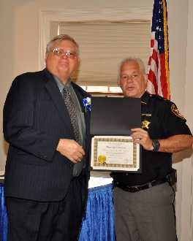
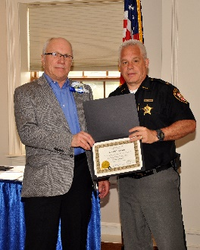
Dayton Chapter of SCORE
Recipient: Charles Anderson
Reason for nomination: Mr. Anderson serves as Treasurer of the Dayton Chapter of SCORE and volunteered to man the office when the clerk was on medical leave. He is conscientious in handling client requests.
Recipient: Robert Puskar
Reason for nomination: Mr. Puskar is dedicated in his volunteer role at Dayton SCORE. When the office clerk was on medical leave he stepped in to help man the office. With the additional burden of caring for an ill wife, he is thorough in his volunteer duties at SCORE.

Slide 9

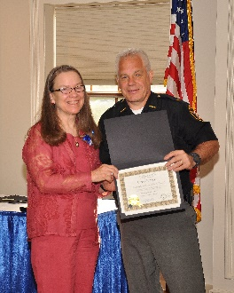
Exchange Club of Dayton
Recipient: Carol Suddath
Reason for nomination: Carol Suddath coordinates Accepting the Challenge of Excellence Program for the Exchange Club of Dayton. A.C.E Program recognizes young people who have overcome hugh odds to be on the threshold of a successful life. For nearly two years, Carol’s network of independent judges identified worthy candidates for tens of thousands of worthy scholarship dollars, including awards representing national recognition.

Slide 10

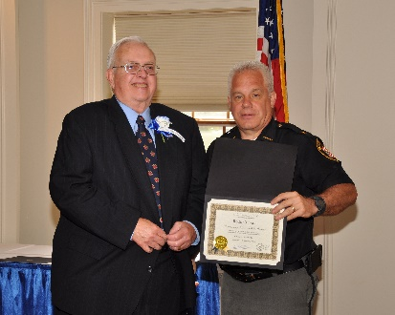
Brookville Kiwanis Club
Recipient: Roland Furnas
Reason for nomination: Roland has been a Kiwanis member since 1988, Past President, Past Distinguished Lieutenant Governor Ohio District, Walter G. Sellers and George Hixon Awards from Kiwanis International. Recruited more than 40 new members and formed new Kiwanis Club. Past President of the Presidents Club of Dayton. Past Officer Brookville Board of Education. Founding Scoutmaster of Boy Scout Troop – Assistant Scoutmaster for 22 years. Active in Church and Masonic organizations.

Slide 11
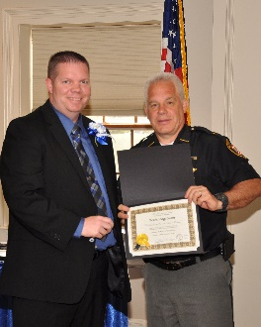
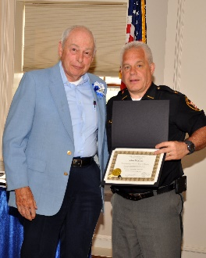
Kettering-Centerville Kiwanis
Recipient: Kevin Hagstrom
Reason for nomination: Kevin Hagstrom, serves as Treasurer for the Kettering-Centerville Kiwanis. He is responsible for preparing the annual budget, collecting and paying dues to Kiwanis International and Ohio District, and management of two required bank accounts. As Chairman of the Finance and Fundraising Committee, Kevin is responsible for initiatives to support to three Key Clubs, Youth in Government Days, and Police Officer of the Year.
Recipient: John McCall
Reason for nomination: John McCall is always there to support whatever project is underway. He is a team leader for the Christmas Tree sales lot. He will do the “dirty work” like cleaning the kitchen at the Ronald Mc Donald House. John is a key participant in preparing monthly meals at Ronald McDonald House and the Kettering summer lunch program for needy children. He is instrumental in construction and delivery of trauma dolls to area hospitals.

Slide 12
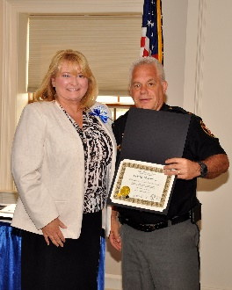
Kiwanis Club of Northridge
Recipient: Colette Moorman
Reason for nomination: Colette is the Secretary for Kiwanis Club of Northridge and we are grateful for her volunteering to take on this task which is very time consuming. Colette does a lot of volunteer work in the community, in addition to our club, she also volunteers at the animal resource center, Dayton Mediation Center, and Mock Trial Competitions. We are very proud of Colette and her efforts and volunteer work for our club and the children we serve, all while working full time as a magistrate and running for Judge of Dayton Municipal Court.

Slide 13
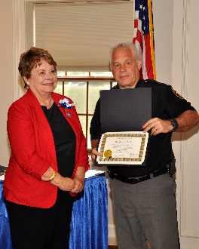
MVMAA
Recipient: Dr. Karen Celik
Reason for nomination: MVMAA F amily Support Chairperson; Long time member in charge of Hearts to Hearts Airman Family Appreciation Programs and annual Harvest Fest at Wright-Patterson Air Force Base. In addition has served as President, President-Elect Vice-President and Secretary for Trotwood Chamber of Commerce. President of Trotwood Community Improvement Corporation. Owner New York Pizzeria.

Slide 14

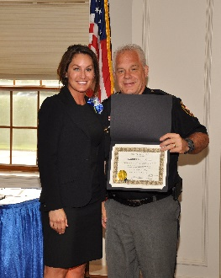
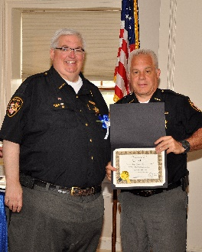
Montgomery County PAAL
Recipient: Shannon Crabtree
Recipient: Larry Lane

Slide 15

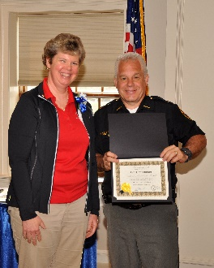
Centerville Noon Optimist Club
Recipient: Karen Young (No Photo)
Reason for nomination: Karen has been a Vice President for two years with the Centerville Noon Optimists Club. In her role she has overseen no less than eleven club community activities. She has also been the driving force for the introduction and implementation of our Communication Contest for the Deaf and Hard of Hearing youth in the state. This required a significant amount of effort to seek out and encouraged challenged youth in our state that would normally not have the opportunity for a scholarship. She is a staunch advocate for quality education for all the youth in our community.
Recipient: Joan Condonnion
Reason for nomination: Joan has served as Vice President of the Centerville Noon Optimists Club for one year and has been elected for a second term. In her role as Vice President she has over seen no less than fourteen community activities. She spearheaded our Adopt a Child Program for the past several years. Over that time we have adopted over one thousand youth during the Christmas holidays. This process included supplying food, clothing and toys for the less fortunate children in our community. Joan has also managed our 5K community run which is held at the Annual Americana Festival, this activity includes over 1500 runners.

Slide 16

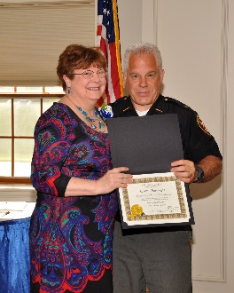
East Dayton Optimist Club
Recipient: Connie Nisonger
Reason for nomination: Connie has been an active member of the East Dayton Optimist Club since, currently serving on the Board of Directors as Past President. We have become aware of and to appreciate Connie’s commitment to service on a very first-hand level. One of Connie’s great gifts is that she is an accomplished quilt-maker. It is hard to imagine how she finds the time to devote to this passion of hers amidst all of her other community work. The East Dayton Optimist Club is just one of the organizations that has benefited from her work. Connie makes quilts and provides them to non-profits to raffle off to raise funds to support their causes. East Dayton was able to generate $1000 from our raffle to support our youth activities, such as our Shoes That Fit Program and Essay Contest. Connie is working on another quilt for this year’s raffle.

Slide 17

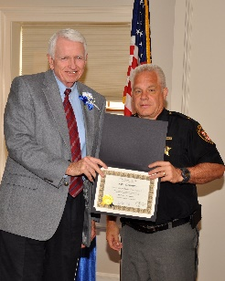
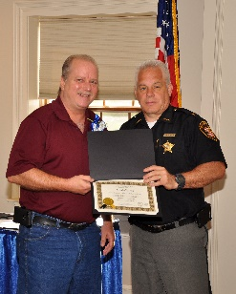
Northridge Optimist Club
Recipient: Mike Gorman
Reason for nomination: Mike has been a longtime active member and this year has been instrumental in 2 major programs Christmas Sharing and the Polar Bear Foundation at Northridge Schools. Christmas sharing is an annual program that members of the North ridge Optimist Club, around Christmas time, grocery shop for needy families in the Northridge School district. Mike helped organized and communicated with the club about the program. The Polar Bear Foundation is a fund seeded with Northridge Optimist monies, and others, to allow teachers to purchase items for their students that is in addition to and compliments the curricula for the Northridge District. This had gone mostly untouched for a few years and Mike has encouraged (through communication with the school) teachers to apply and use this money. To date well over $4000 has been awarded to individual teachers to be used in their classrooms.
Recipient: Chris Young
Reason for nomination: Chris has been instrumental in developing and deepening our relationship with the Cargill Company and with his help and organizational skills many other employees have donated their time and efforts to the activities of the Northridge Schools. This partnership with Cargill and the Northridge Optimist Club has continued to grow over the years and our community is grateful to Chris and the Cargill Company not only with some financial support but more importantly with the hours of service given to the community through the Northridge Optimist Club. Chris also took on added duties this past year in supporting our golf outing fundraiser and helping with the Christmas sharing program.

Slide 18
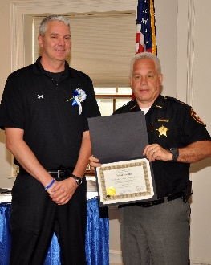
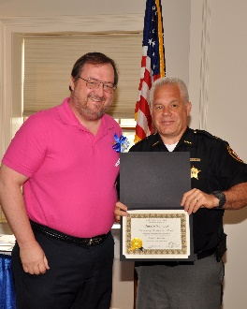
Riverdale Optimist Club
Recipient: Brian Kremer
Reason for nomination: Brian Kremer joined the Riverdale Optimist Club in 2006, representing Building Bridges. Brian has organized the Building Bridges Softball Tournament that Riverdale sponsors along with several other members. He served as President in the 2013-14 Optimist year, has served on our Board of Directors, and chaired one of our big fundraising events successfully.
Recipient: Dennis Marlow
Reason for nomination: Dennis Marlow joined Riverdale in 1997. He served for many years on our Board of Directors and also chaired the Building Bridges Softball Tournament for fifteen years.

Slide 19

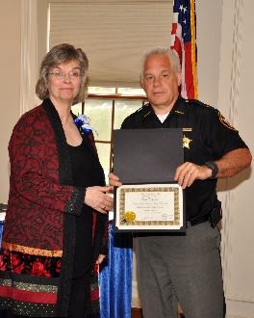
Rotary Club of Dayton
Recipient: Sue Taylor
Reason for nomination: Sue currently works on the Rotary Club of Dayton Board of Directors as the Director of Education. In that role, she is responsible for the six committees that facilitate our Dayton Public School and DECA outreach. Sue has also served on the following committees: Social (also served as Chair), Remembrance and Visitation, Welcome, Rotary Reads, Ethics in Business, Blue Ribbon and RYLA (also served as Chair). She was Sergeant at Arms and served two years on the Board as the Membership Relations Director. Since joining the Club in March of 2008. Sue has been extremely active in all aspects of the organization and is very deserving of the honor of Outstanding Club Member.

