Slide 1

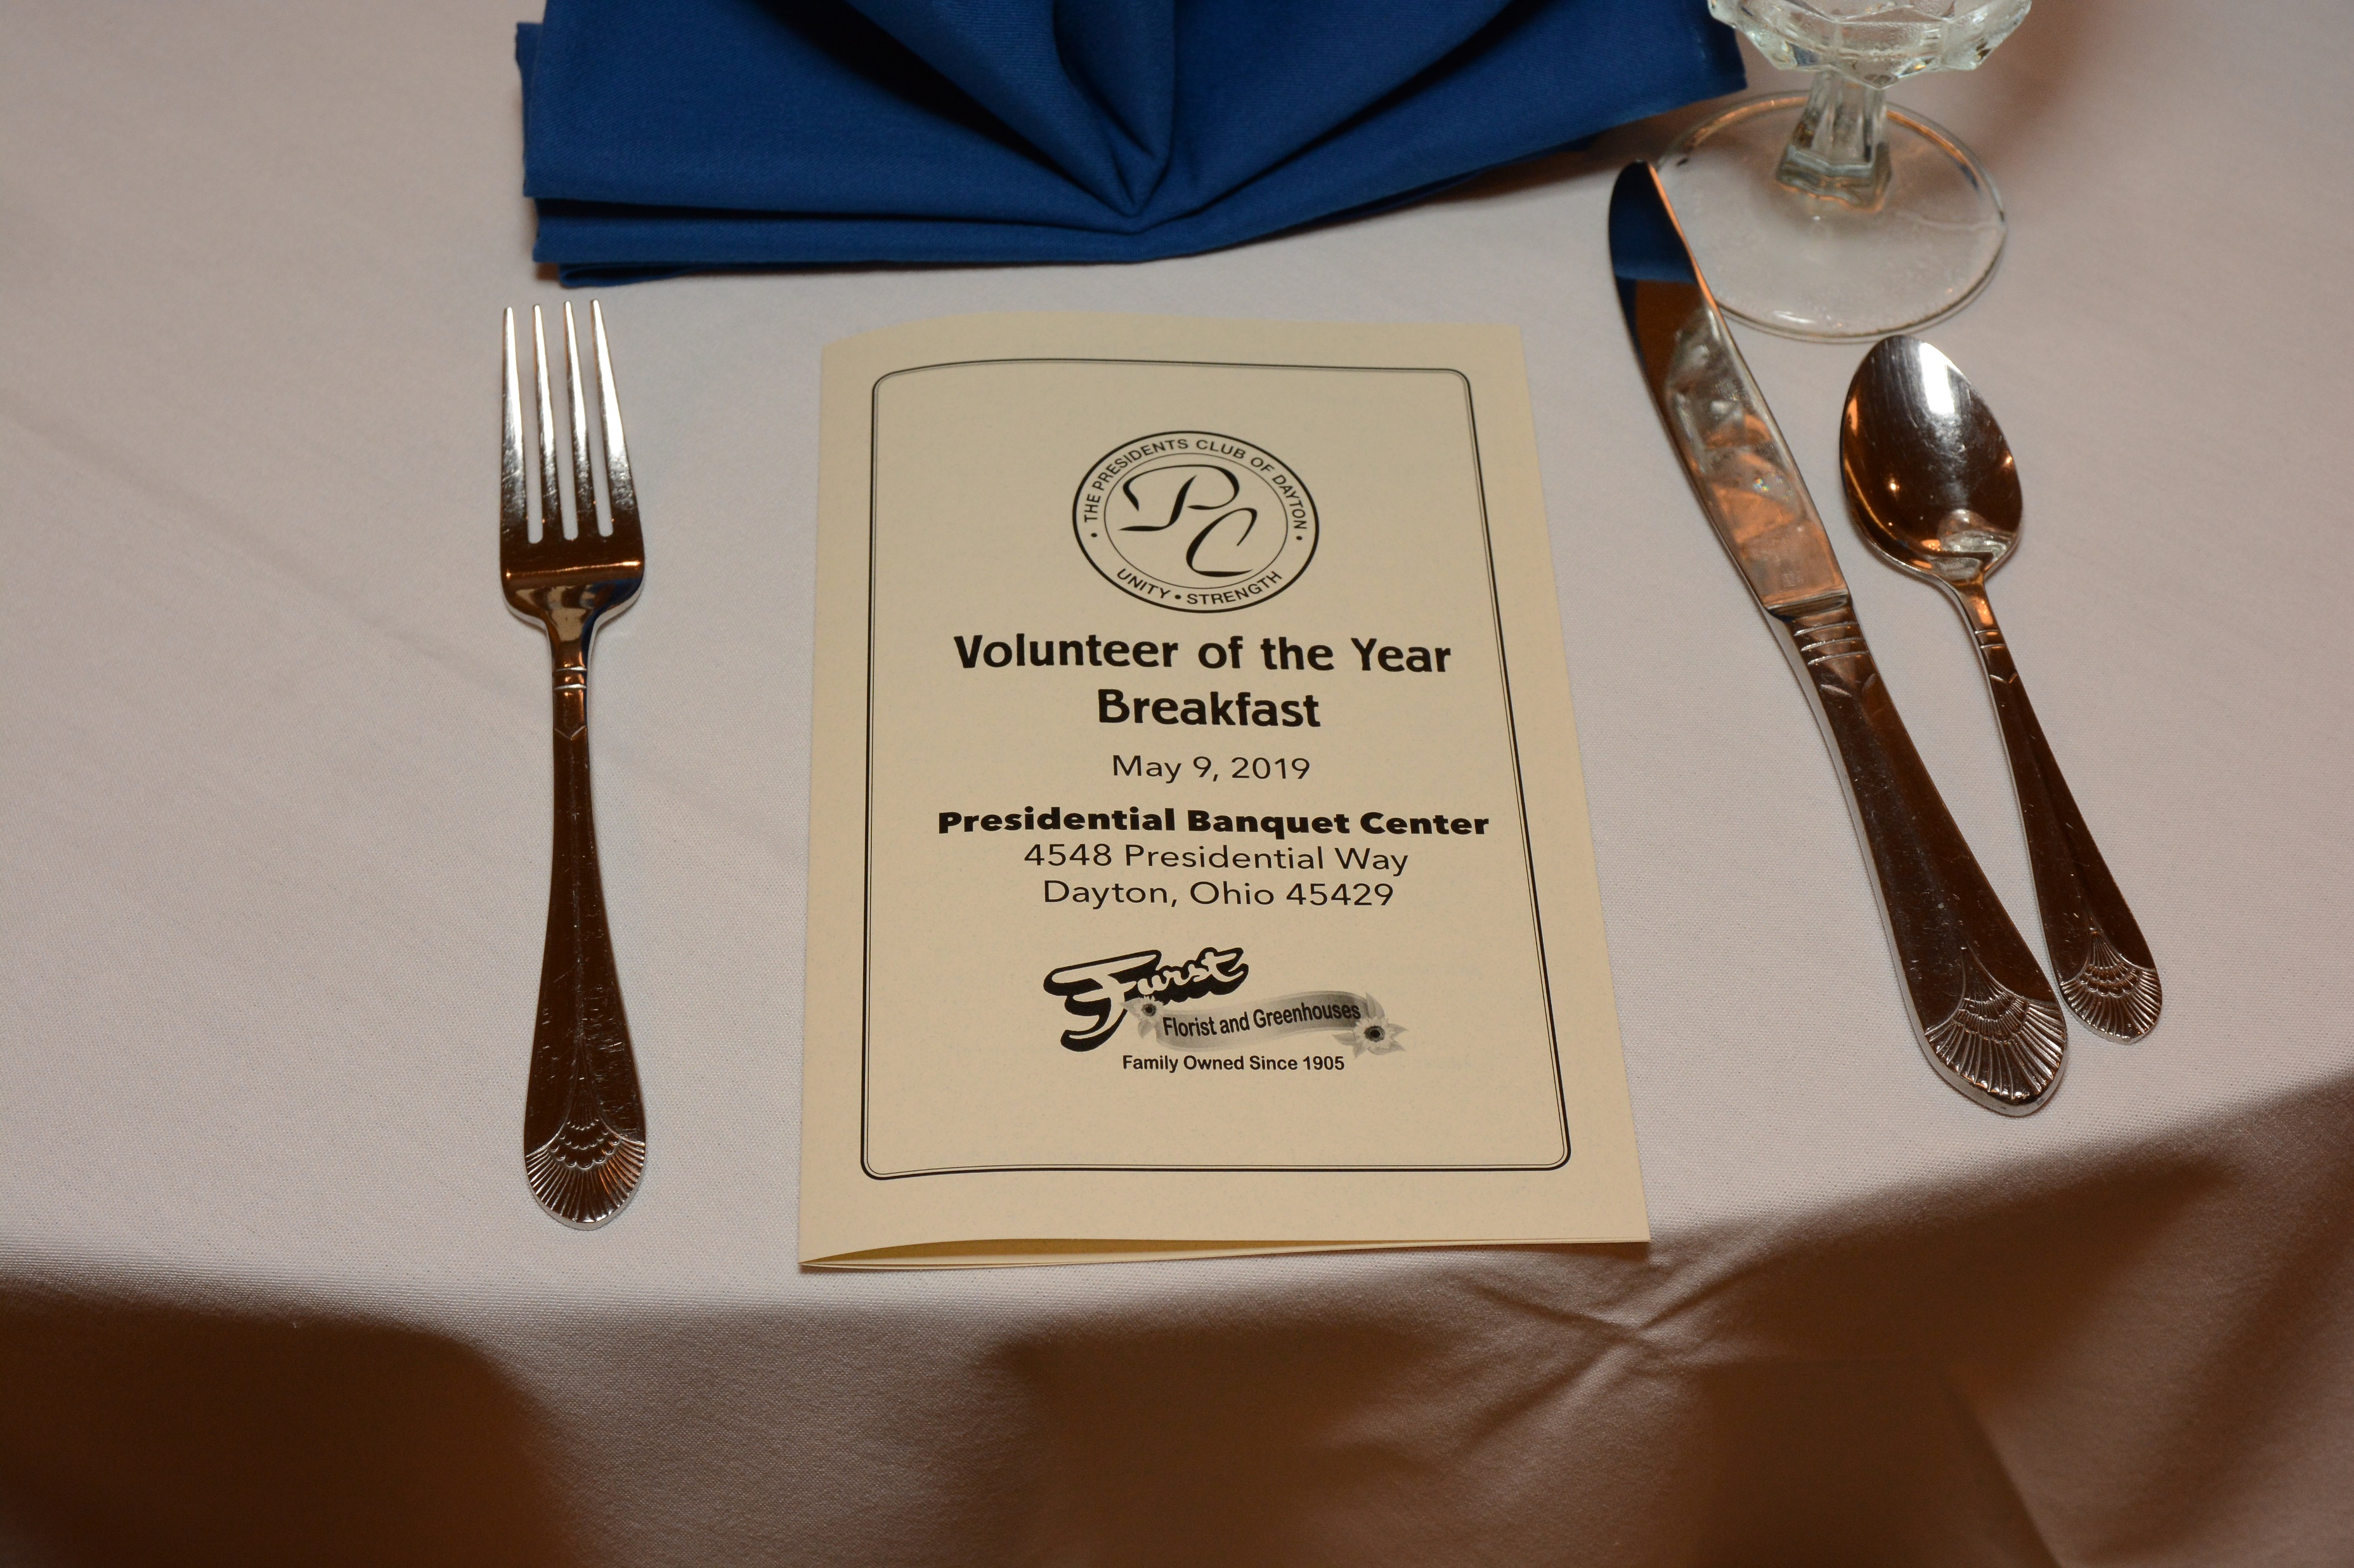
Presidents Club of Dayton
Outstanding Volunteers of the Year
May 9, 2019
Presidential Banquet Center

Slide 2
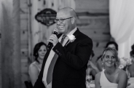
Steve Rudisill Executive Pastor
Christ United Methodist
Pastoral Ministry is a second career for Pastor Steve as he spent 20 years in sales prior to answering his call, predominantly at Johnson and Johnson in Pharmaceutical Sales. Steve strongly believes that the local church is still the greatest tool God uses to change the world. He is particularly passionate about the people who have had a bad church experience or have no church history at all and bringing them to know a life with Christ. He believes we have God given talents so that we can share them with others. His favorite saying is “We are blessed to be a blessing.” Steve is from the Dayton area and has been married to Tina since 1999. They are the proud parents of teenage sons Brady and Tate. Steve loves to perform music, is a huge super hero geek (prefers marvel) and is most happy if he is wherever his wife and kids are.

Slide 3
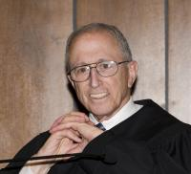
Master of Ceremonies Walter Rice
Judge Rice was born in Pittsburgh, Pennsylvania. He is a graduate of Northwestern University, receiving a B.A. degree in 1958.
He attended the Columbia University School of Law and received a Juris Doctorate degree in 1962. He also attended the Columbia University Graduate School of Business Administration and received a Master of Business Administration in 1962. He received an Honorary Degree, Doctor of Laws, from the University of Dayton, in 1991 and an Honorary Degree, Doctor of Humane Letters, from the Wright State University in 2000.
Judge Rice began his law career as an Assistant County Prosecutor for Montgomery County, Ohio, in 1964. He left that position in June, 1966 and became an associate with the law firm of Gallon & Miller. In June, 1969, Judge Rice returned to the Montgomery County Prosecutor's Office as its First Assistant Prosecuting Attorney. He was elected Judge of the Dayton Municipal Court in November, 1969, and served in that position until July, 1971, when he was appointed Judge of the Court of Common Pleas, Montgomery County, Ohio. He was re-elected to the Court of Common Pleas in 1972 and in 1978.
On June 4, 1980, Judge Rice was sworn in as Judge of the United States District Court for the Southern District of Ohio, at Dayton, having been appointed to that position by President Carter.
Judge Rice served as Chief Judge of the United States District Court for the Southern District of Ohio from October 13, 1996 to October 12, 2003. Judge Rice was the recipient of the Thomas J. Moyer award for judicial excellence in 2014 and Judge Rice received the 2019 Brother Raymond Fitz Award

Slide 4

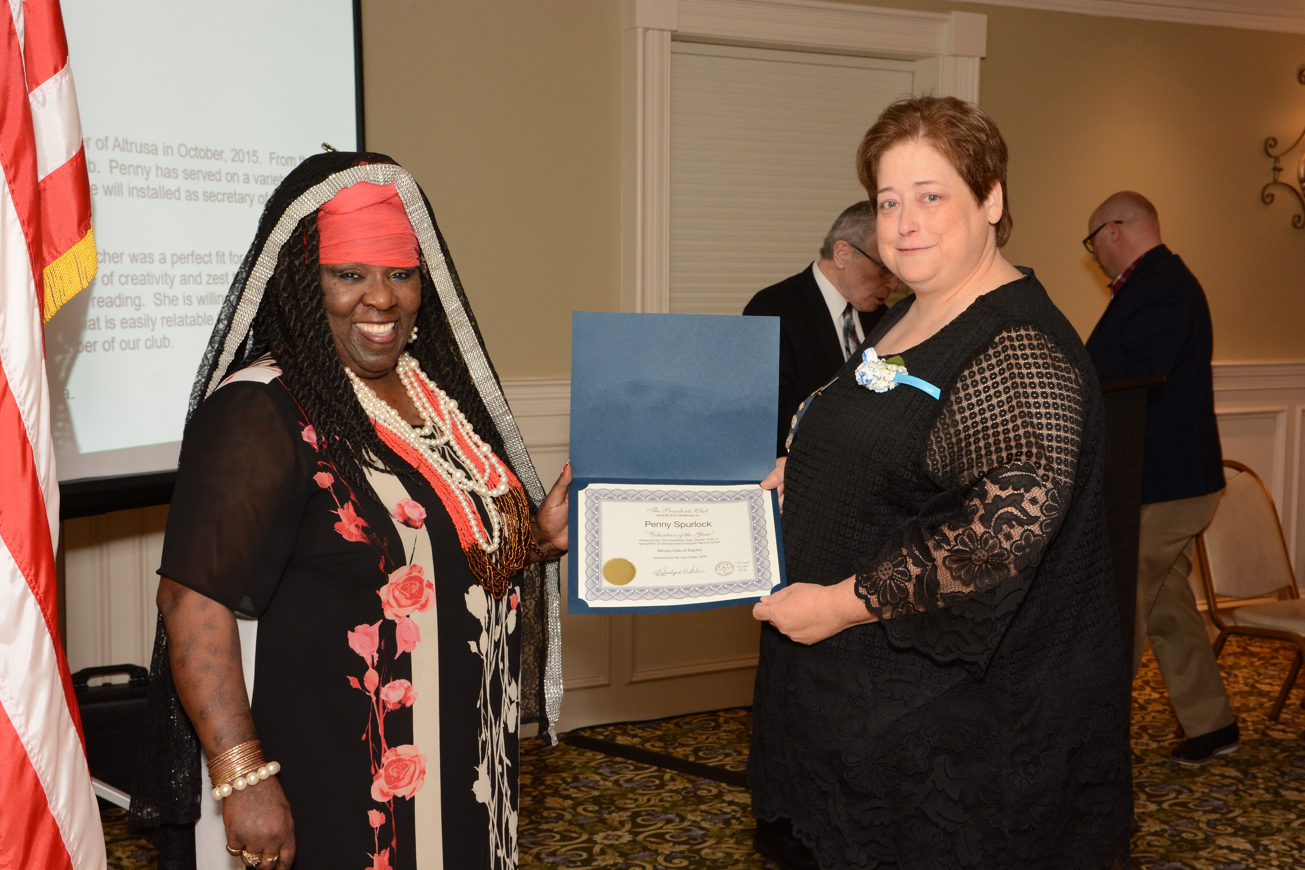
Altrusa Club
Recipient: Penny Spurlock
Reason for nomination: Penny became a member of Altrusa in October, 2015. From the start, she has been an active member of the club. Penny has served on a variety of committees and as a Director on our Board. She will installed as secretary of our club's foundation, later this month.
Penny's profession as an elementary school teacher was a perfect fit for our club and its mission to promote literacy. She brings a sense of creativity and zest to our service projects, particularly those involving children & reading. She is willing to pitch in, wherever needed with an enthusiastic smile that is easily relatable to the children.
We are very fortunate to have her as a member of our club.
Thank you, Penny, for all you do for Altrusa.

Slide 5

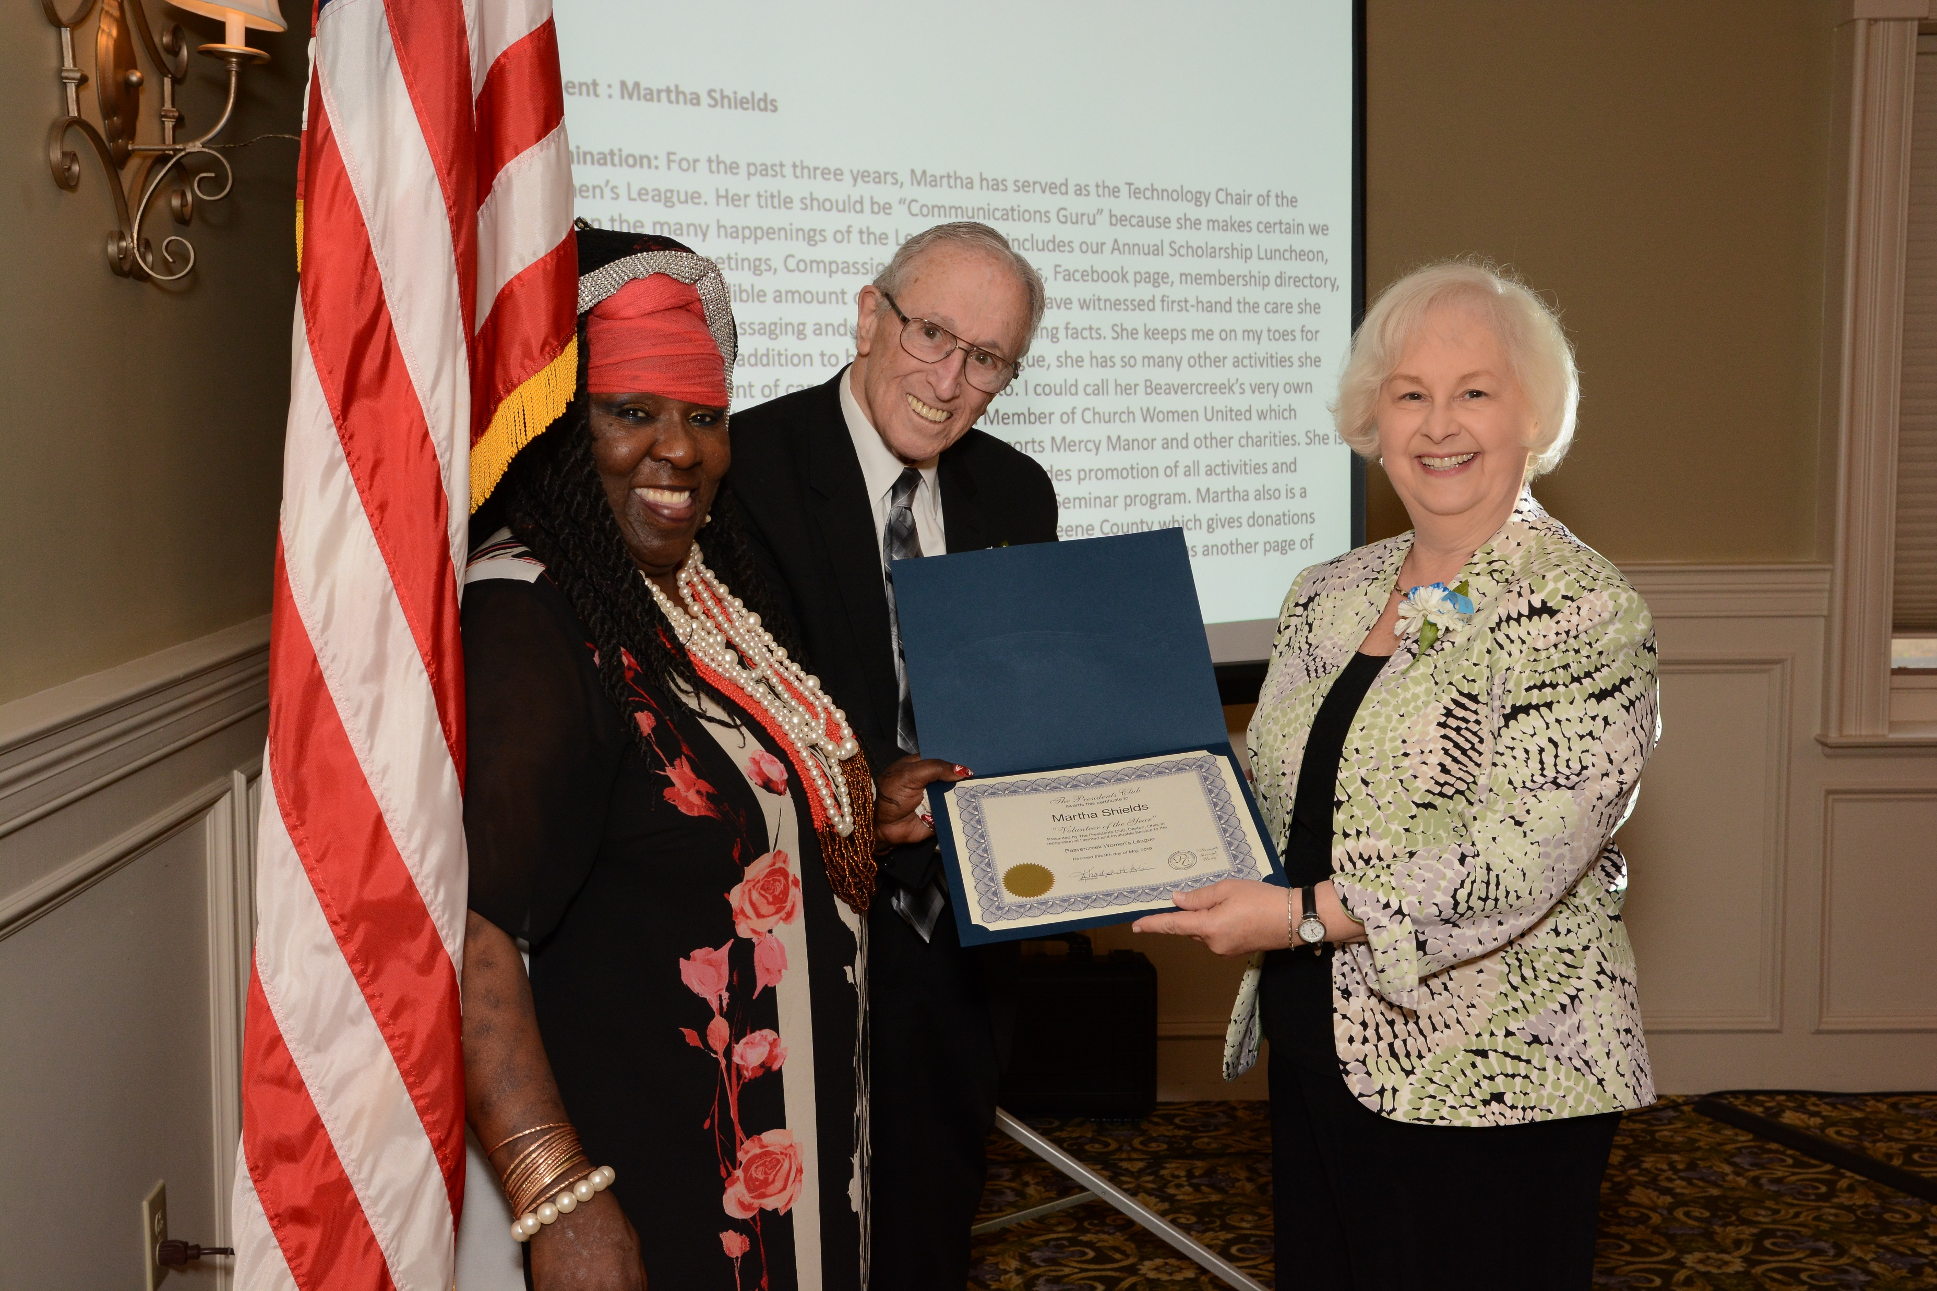
Name of Recipient : Martha Shields
Reason for nomination: For the past three years, Martha has served as the Technology Chair of the Beavercreek Women’s League. Her title should be “Communications Guru” because she makes certain we are all up-to-date on the many happenings of the League. This includes our Annual Scholarship Luncheon, Lunch and Learns, monthly meetings, Compassionate Care updates, Facebook page, membership directory, and website. She gives an incredible amount of time in this role. I have witnessed first-hand the care she takes with being precise with messaging and always double-checking facts. She keeps me on my toes for which I am eternally grateful! In addition to her work in the League, she has so many other activities she provides exactly the same amount of care and consideration to. I could call her Beavercreek’s very own “Superwoman” for all that she does. She serves as a Board Member of Church Women United which represents 50 churches in the Greater Dayton area which supports Mercy Manor and other charities. She is an Emeritus Board member of the Muse Machine where she provides promotion of all activities and financially supports the musicals and the Advance Teacher Training Seminar program. Martha also is a member who attends quarterly meetings of the 100+ Women of Greene County which gives donations upwards of $11,000 four times a year to selected Greene County charities. There was another page of accolades for Ms. Shields.

Slide 6
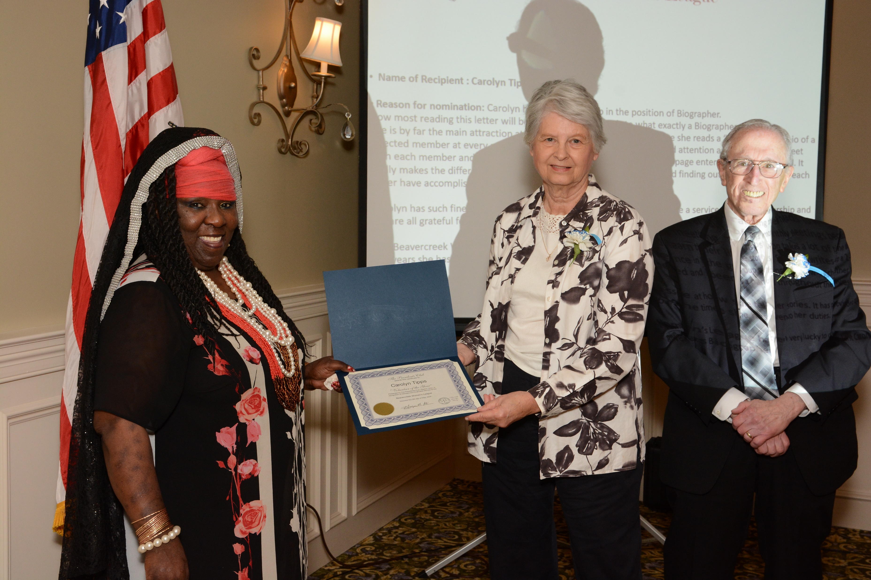
Name of Recipient : Carolyn Tipps
Reason for nomination: Carolyn has served the club in the position of Biographer.
Now most reading this letter will be scratching their heads to what exactly a Biographer does.
She is by far the main attraction at all of our monthly meetings because she reads a “featured-style” bio of a selected member at every meeting. This position takes a lot of time and attention as Carolyn has to meet with each member and learn their life stories. She then writes-up a 2-3 page entertaining story to read. It really makes the difference in the group getting to know each other and finding out what great things each other have accomplished and been a part of throughout their lives.
Carolyn has such finesse at how she tells her stories. It has provided quite a service to our membership and we are all grateful for the time she has given to her duties.
The Beavercreek Women’s League has been very lucky to count Carolyn Tipps as part of their leadership for the years she has given as Biographer!

Slide 7

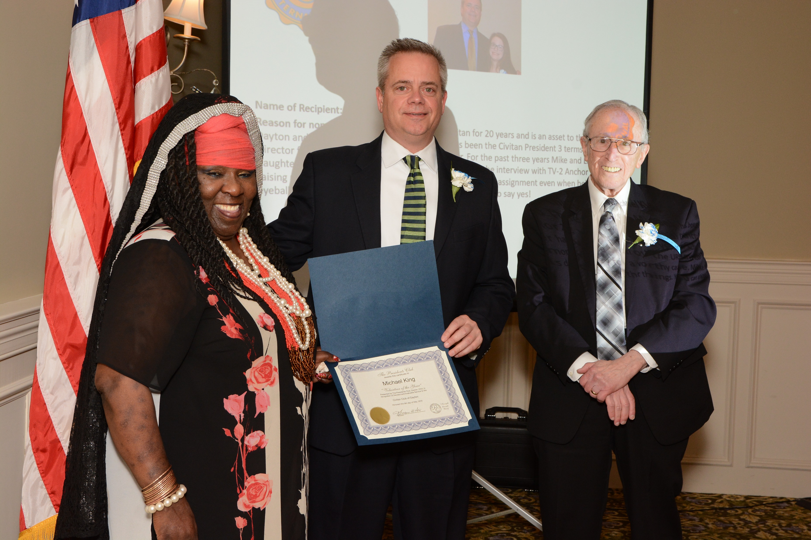
Civitan Club of Dayton
Name of Recipient: Michael King
Reason for nomination: Michael has been a Civitan for 20 years and is an asset to the Civitan Club of Dayton and The Civitan Cardinal District. Mike has been the Civitan President 3 terms, a District Director for 2 yrs. and this year the Club Treasurer. For the past three years Mike and Lauren his daughter have been on the URS Annual Telethon doing the interview with TV-2 Anchor Mark Allen raising money for a worthy cause. Mike never says no to an assignment even when he's up to his eyeballs doing other things. You can always count on Mike to say yes!

Slide 8

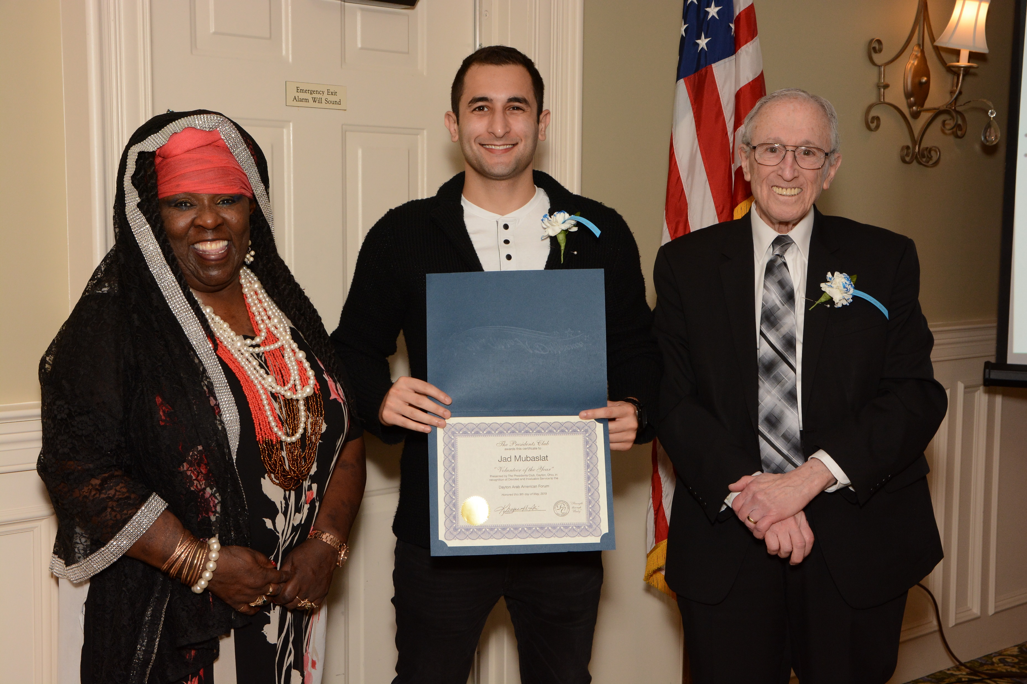
Dayton Arab American Forum
DAAF
Name of Recipient: Jad Mubaslat
Reason for nomination: Jad has been a Dayton Arab American Board member for 1 year since March 2018, but before his appointment to the Board, Jad volunteered to take on the responsibility of managing the DAAF Website. He took the initiative to reprogram the entire website in Word Press and added capabilities that were needed for looking more professional and the ability to use Paypal for dues and events. In addition to managing the Website, Jad has also taken on the responsibilities for the DAAF Database. He's a tremendous asset!

Slide 9

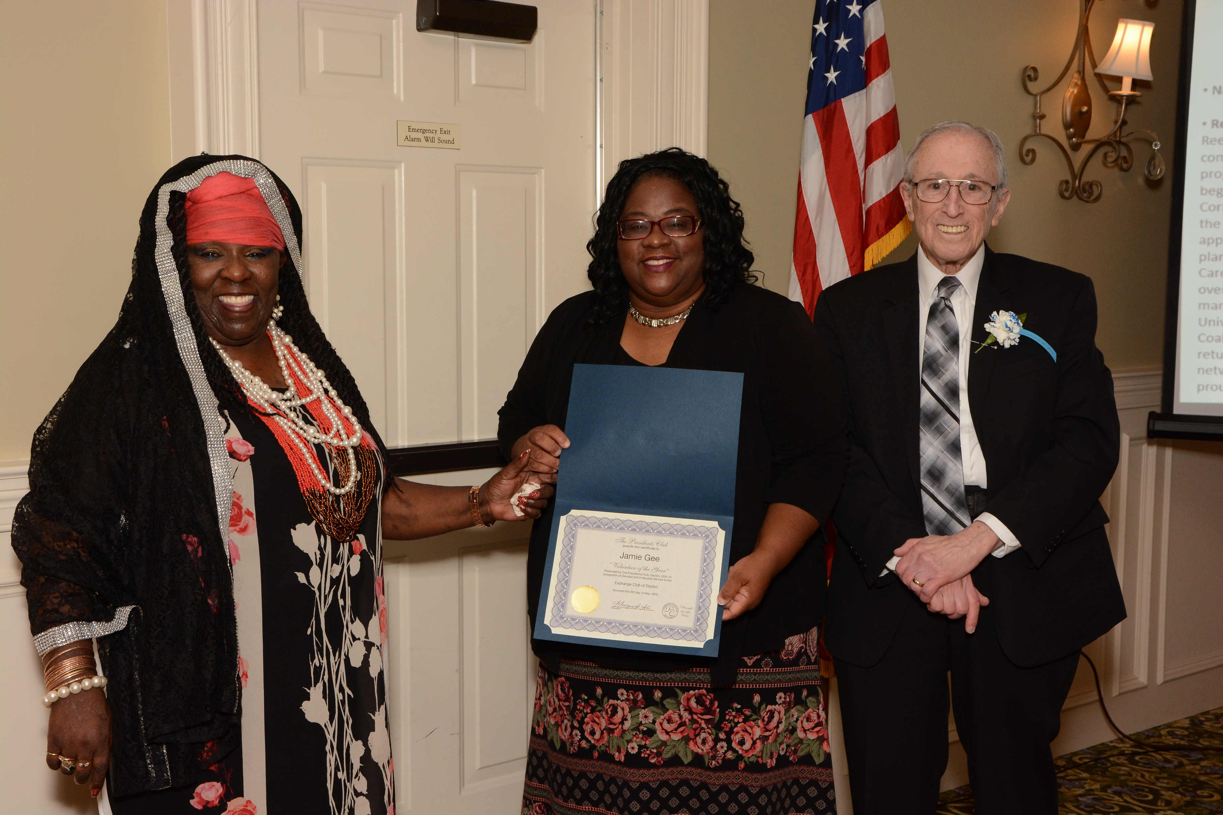
EXCHANGE CLUB of DAYTON
Name of Recipient: Jamie Gee
Reason for nomination: Jamie has been serving as the Managing Officer of the Montgomery County Office of Reentry for the last 8 years and has over 29 years of experience within the correctional, treatment, parole, and community reentry services arena. The Office of Reentry serves the citizens of Montgomery County with programs & services that minimize barriers to effective reentry and promote a reduction in recidivism. Jamie began her criminal justice career with the Ohio Department of Rehabilitation and Correction (ODRC) at Warren Correctional Institution in 1989 and served in various capacities until transfer as a prison Correction Specialist to the Cincinnati Regional Adult Parole Authority as a Regional Reentry Specialist in 2005. In 2010, she was appointed as the Program Director/Manager of the Montgomery County Office of Reentry. Jamie manages the planning, development, and implementation of Office of Reentry programs and services; such as the Reentry Career Alliance Academy program (a service integration partnership model) created in 2015, which has graduated over 469 reentry participants. She is a dedicated pioneer with multi-faceted criminal justice, leadership, and management expertise; and possesses her BA in Criminal Justice from Wilmington College, and MBA from the University of Phoenix. Jamie currently serves as the Vice President of the Ohio Association of Local Reentry Coalitions. Through leveraged partnerships, the Office of Reentry is dedicated to addressing the holistic needs of returning & restored citizens of Montgomery County, through effective resource optimization, coordination, network and advocacy. She is committed to helping people transform obstacles into opportunities. Jamie is the proud mother of Jada Gee, a beautiful & talented actress and Senior from the Stivers School for the Arts.

Slide 10
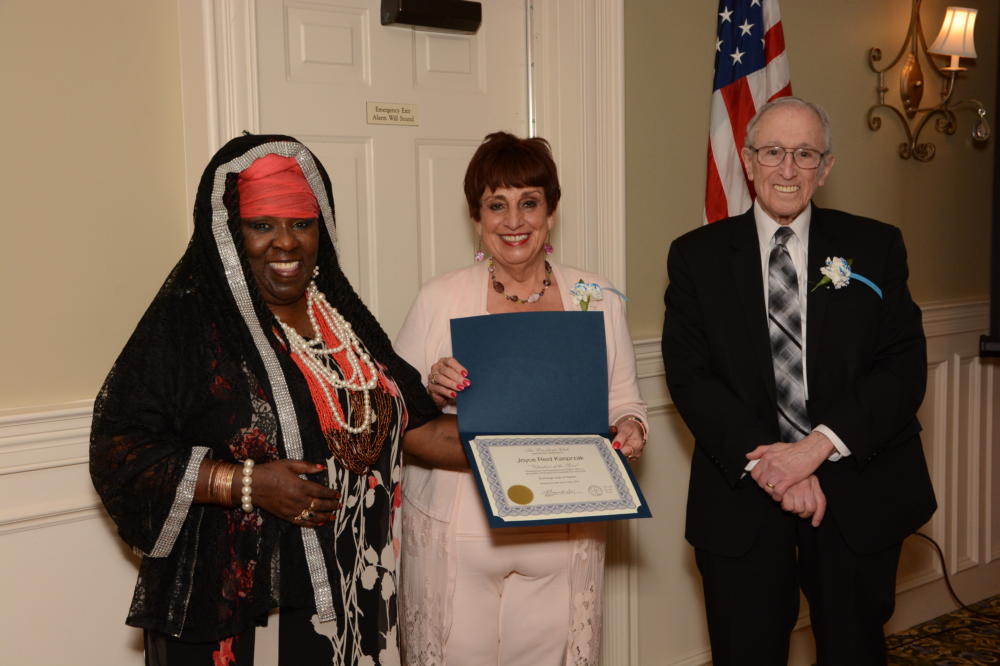
EXCHANGE CLUB of DAYTON
Name of Recipient: Joyce Reid Kasprzak
Reason for nomination: Joyce Reid Kasprzak’ s affiliation with education began as a reading and language arts specialist in Dayton Parochial Schools from 1969 to 1973. She began working with the nonprofit Home Based Arts (HBA) as a volunteer in 2000 before becoming the Executive Director in 2006, after the passing of Founder William Bell. Before joining the organization, Joyce was Founder and CEO of the Dayton/Toledo/Columbus region of The Diet Workshop for more than 25 years. The national headquarters in Boston commended her franchise as the largest and most successful in the company’s history. Honored by the New York Times for outstanding work in corporate weight loss programs, her innovation and vision won her Dayton's Female Entrepreneur Award. In 2010, Joyce was recognized by the Dayton Daily News as one of the Top Ten Women for community contributions. She continues to serve as the Executive Director of HBA’s Children’s Historical Publishing division, which has placed over 500,000 learning-activity books in the hands of minority and at-risk children. Joyce lives in Washington Township with her husband, Alan Kasprzak, and visits her son, Brian, in Los Angeles as often as possible.

Slide 11

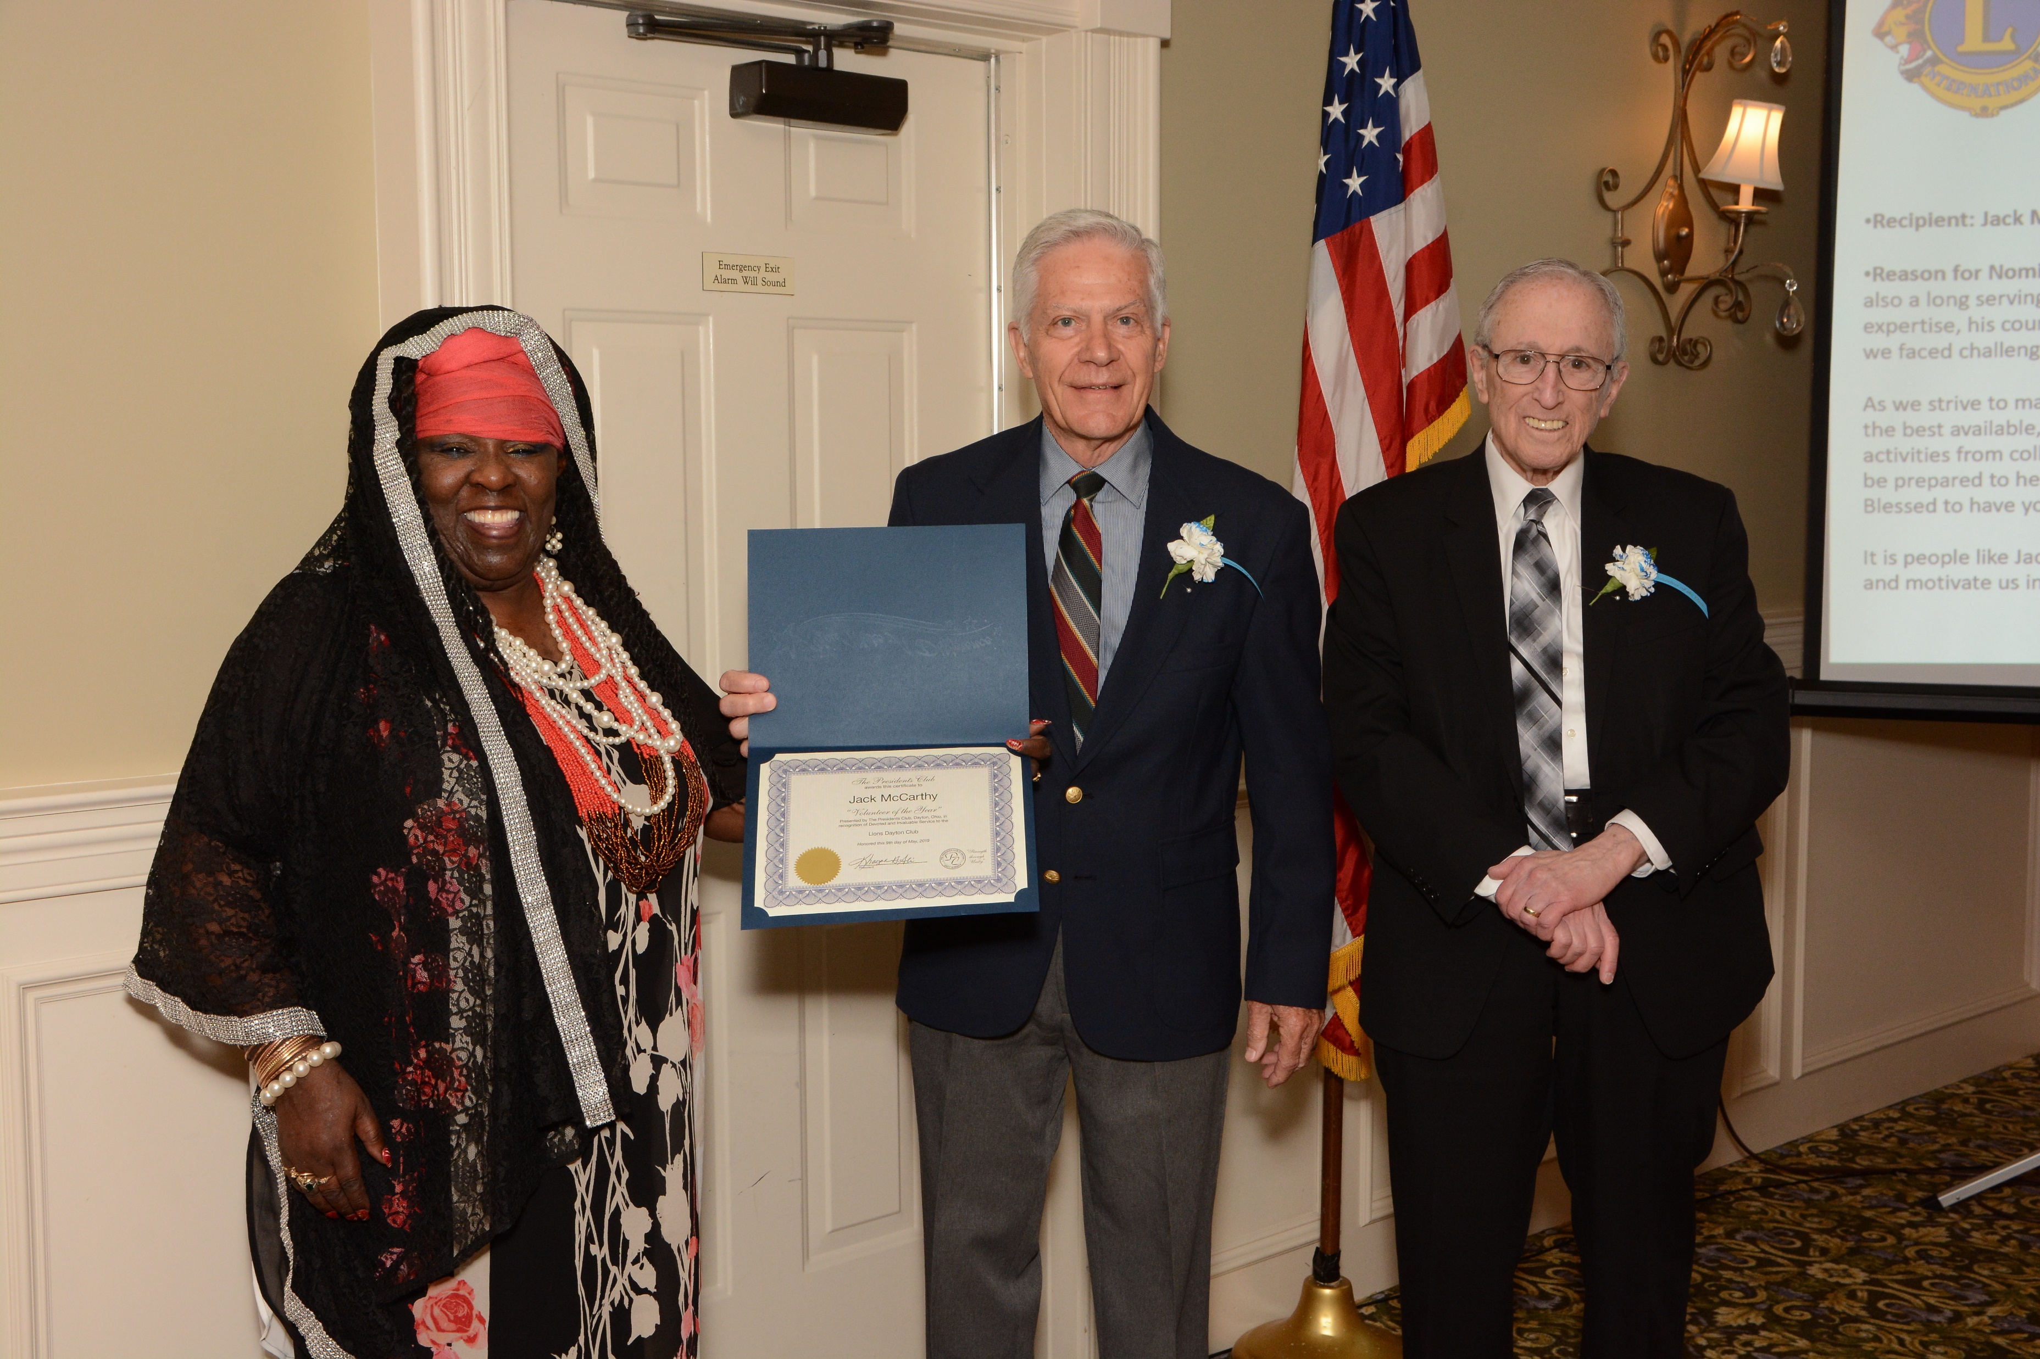
Lions - Dayton Club
Recipient: Jack McCarthy
Reason for Nomination: Jack is the Treasurer and CFO of the Lions Eye Bank of W Central Ohio. Jack is also a long serving member of the Eye Bank. We acknowledge Jack for his intellect, his financial expertise, his courage in making a meaningful contribution to the stability of our Eye Bank during a time we faced challenges very few organizations confront.
As we strive to make our Eye Bank meet it’s 501C3 requirements which insure our quality corneas to be the best available, we know this is the only true avenue to growth. He is always one to support all of our activities from collecting used glasses to driving them to the Ohio Optimetric Department so they may be prepared to help people all over our globe enjoy the “Right to Sight”. We are proud of you Jack and Blessed to have you in our Downtown lions Club.
It is people like Jack McCarthy who will insure the Rich Heritage of our 99 Year “Young” Club will guide and motivate us into a Bright Future.

Slide 12
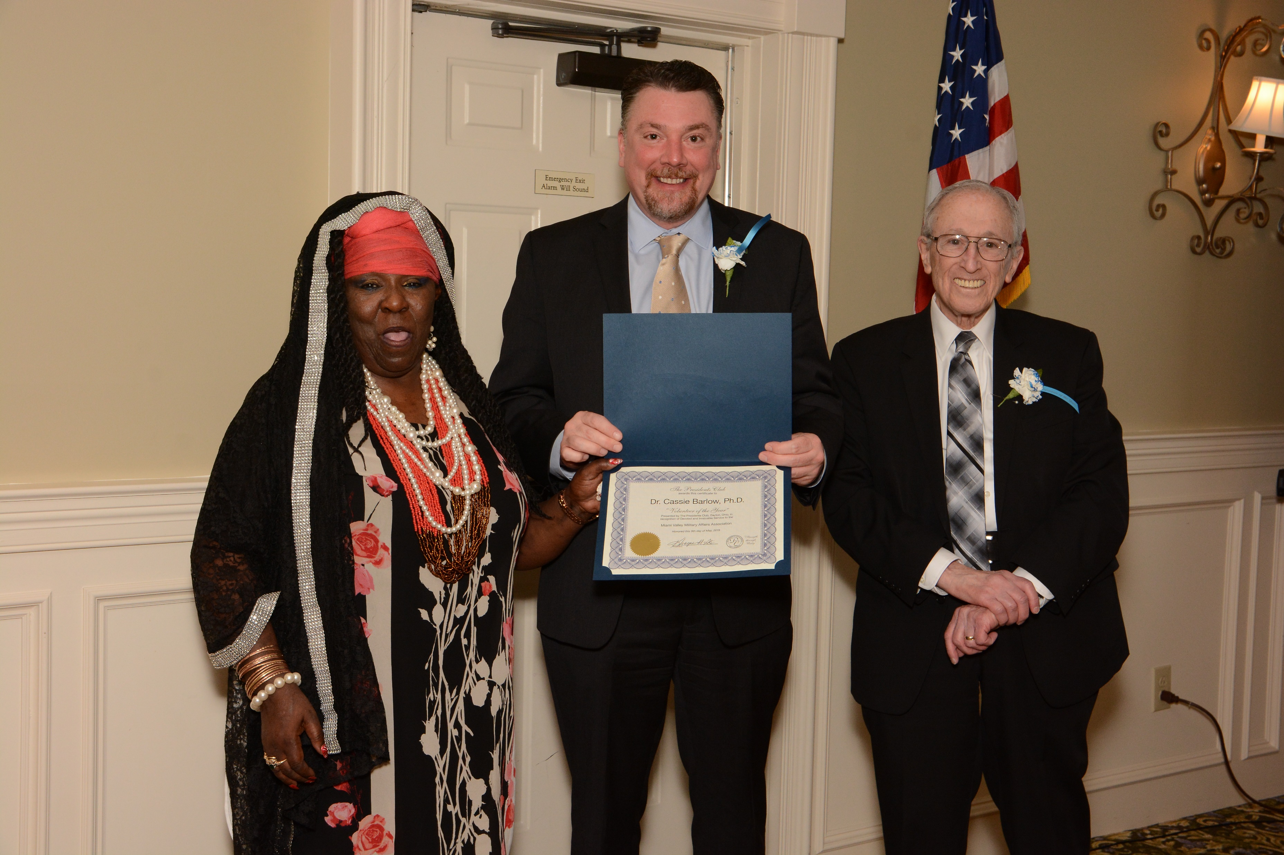
Miami Valley Military Affairs Association MVMAA
Recipient: Cassie Barlow
Reason for nomination: As the Interim President of SOCHE, Dr. Cassie B. Barlow is focused on the workforce needs of 200,000 students at regional institutions. She was the 88th ABW and Installation Commander at WPAFB, and retired as colonel in 2014. She volunteers extensively and is consistently recognized as one of the most influential leaders in the region.

Slide 13

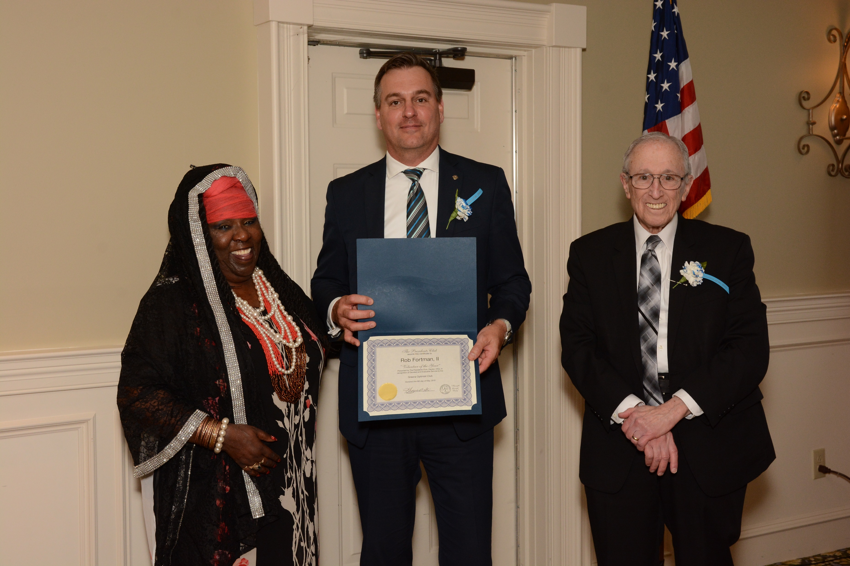
Optimist – The Greene Club
Recipient: Rob Fortman II
Reason for nomination: Rob has provided exemplary leadership for the Greene (Beavercreek) Optimist Club for two years. The club is a small service organization with about 35 members. Optimist clubs are friends of youth and provide dollars to support youth programs in the community. The major source of income comes from the Avenue of Flags program that has expanded from less than 100 American Flags to more than 200. He has helped the club expand with other youth programs to help the community. Rob has driven the club to increased membership and increased donations.

Slide 14
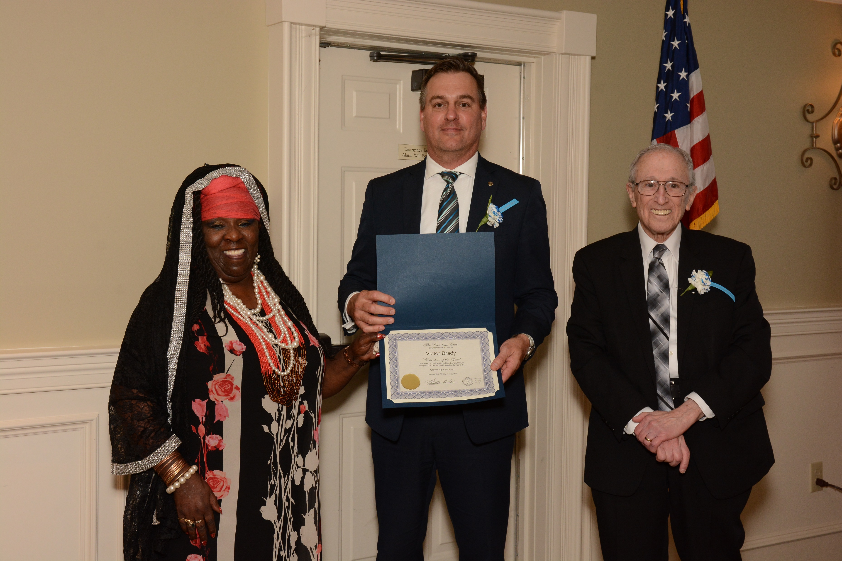
Optimist – The Greene Club
Recipient: Victor Brady
Reason for nomination: Victor is the Heartland Hospice Chaplain and a very loyal Greene Optimist member. While other Optimist Clubs in the Beavercreek area have failed throughout the years, Victor has been very active in the resurgence of the current club. He singlehandedly proposed, planned and driven "dinners for the Ronald McDonald House" for visitors with children undergoing treatment at Dayton Children's Hospital. He arranges the dinners, buys and cooks the meals and assure that other club members are there to assist his efforts. More than 50 are served monthly.

Slide 15

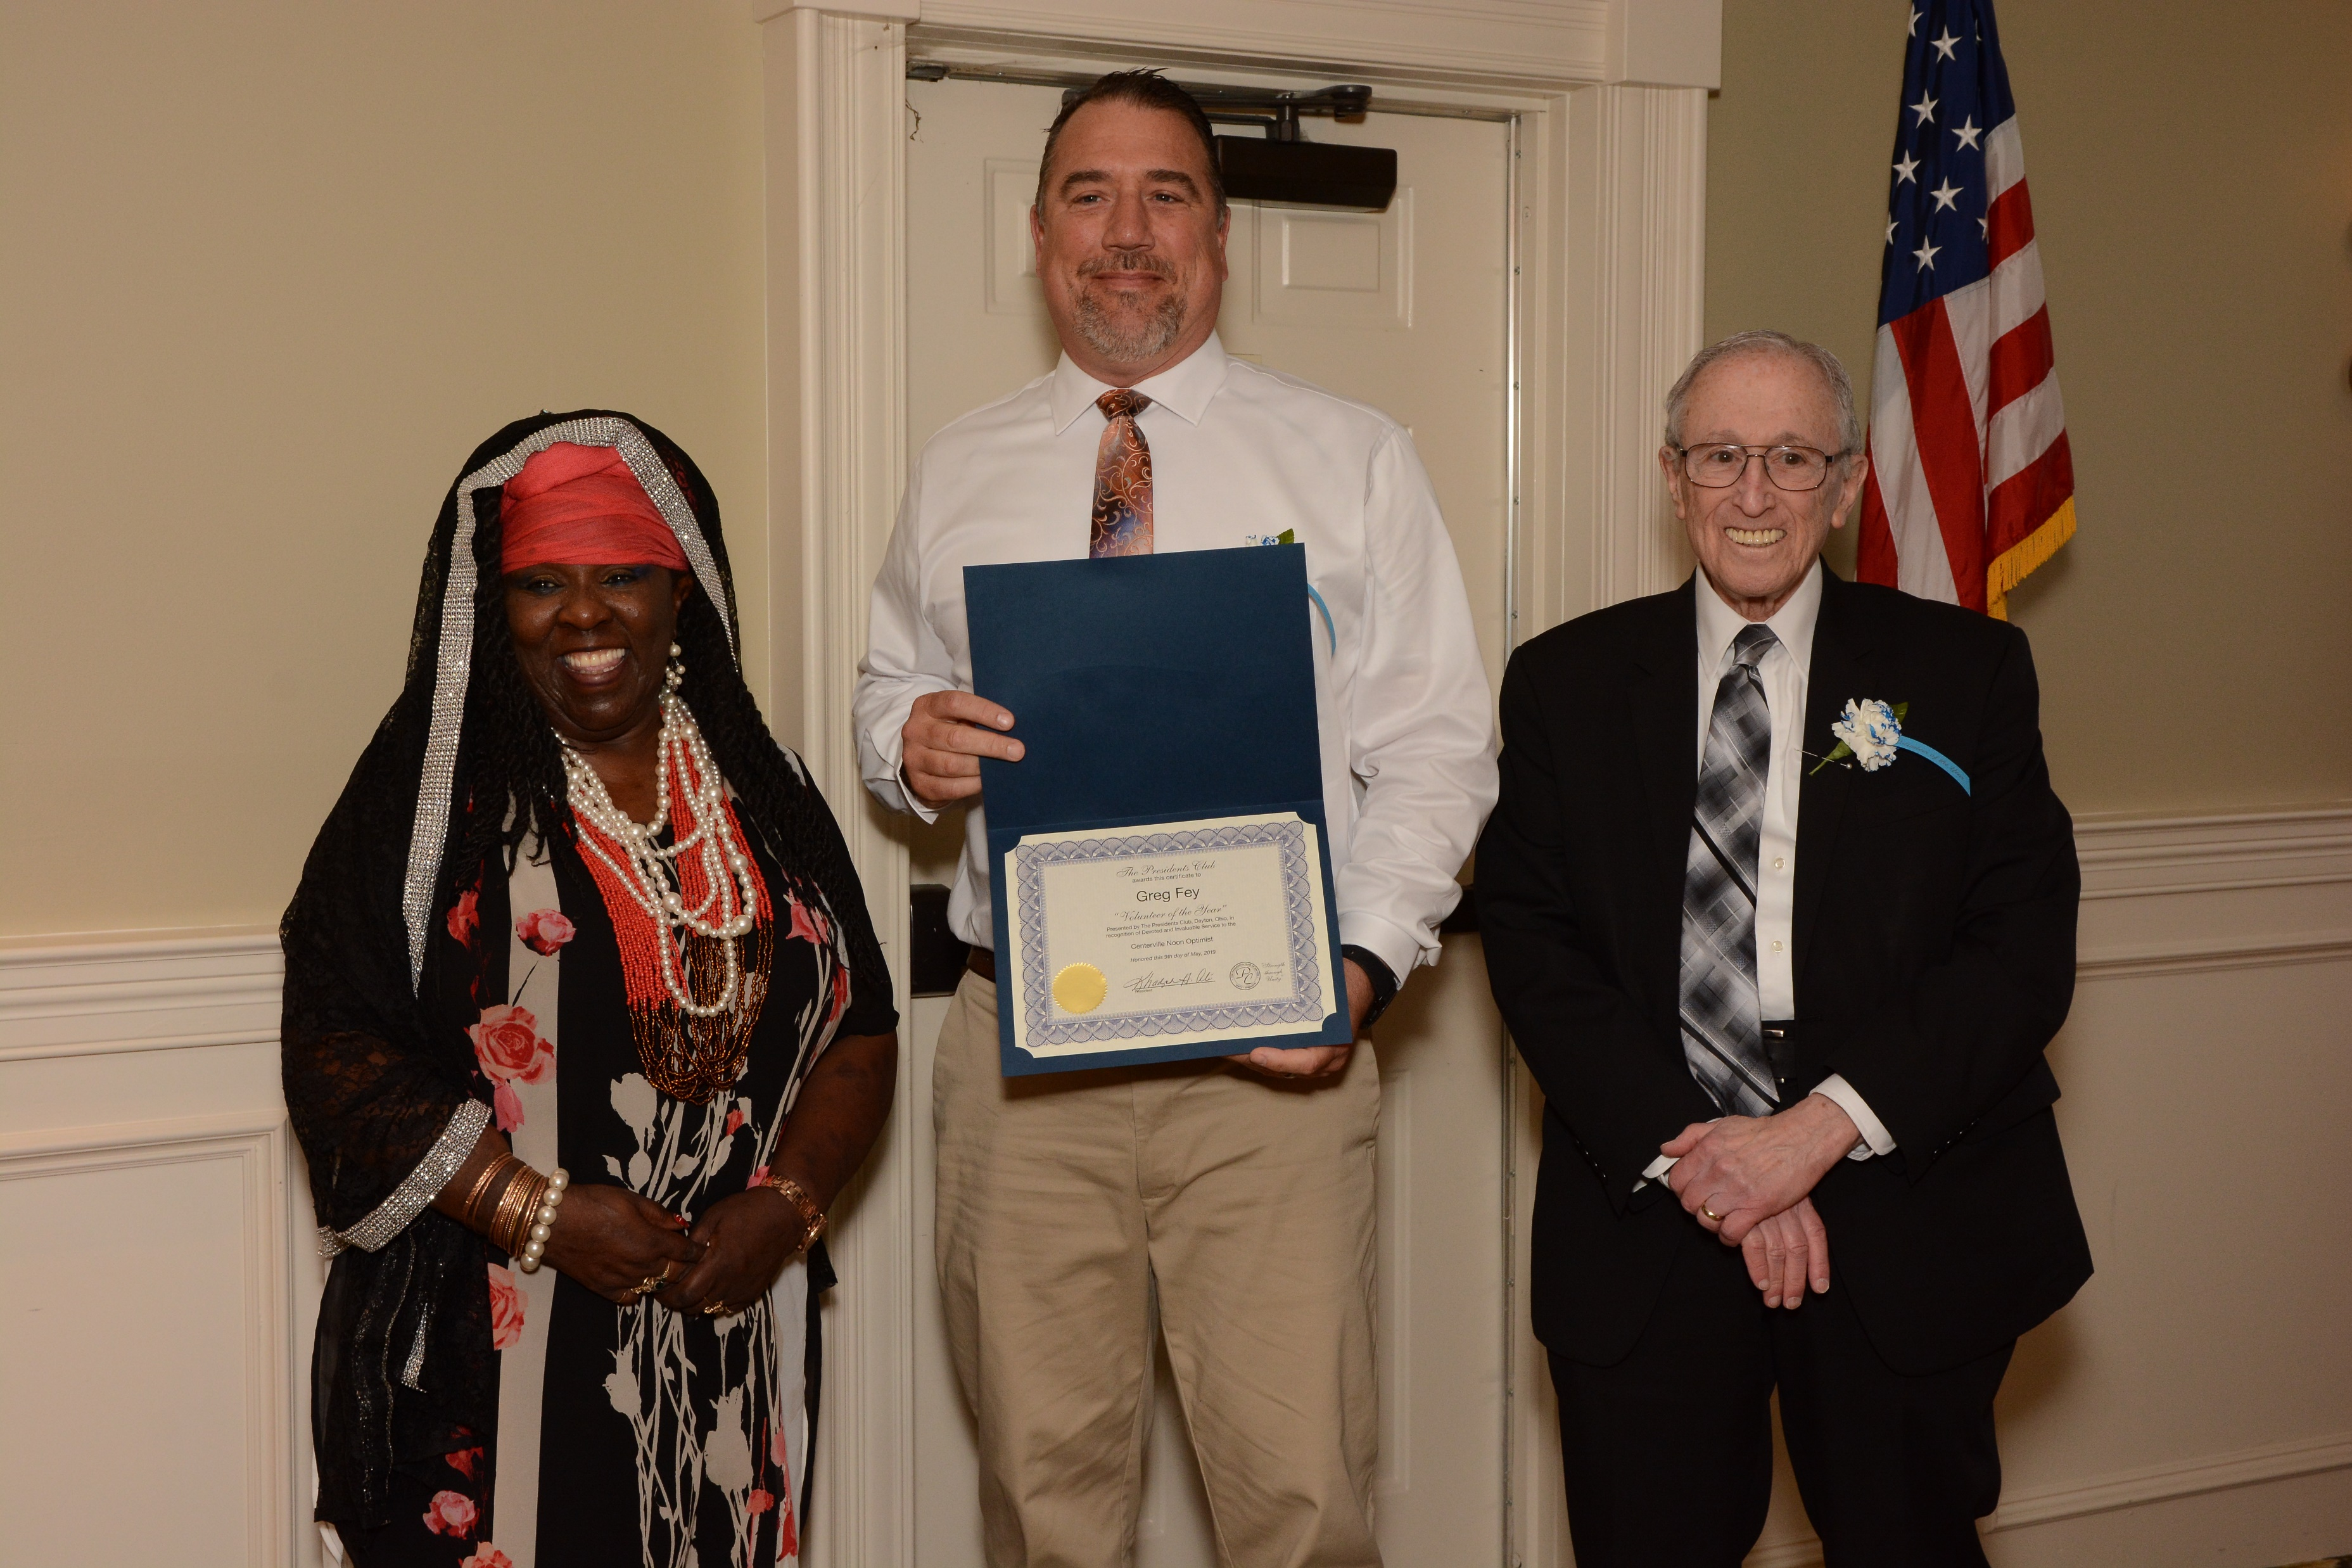
Optimist – Centerville Noon Club
Recipient: Greg Fay
Reason for nomination: Greg has been a member since 2014. Greg volunteers on the Avenue Of Flags, has served on the Board and on the Membership Committee. Due to Greg’s tenacity to forge ahead on a new idea, a new club was developed within the CNO club, which increased the membership by 20+ members during the 2017-2018 term. Besides his involvement, this individual is a small business owner and a veteran.

Slide 16
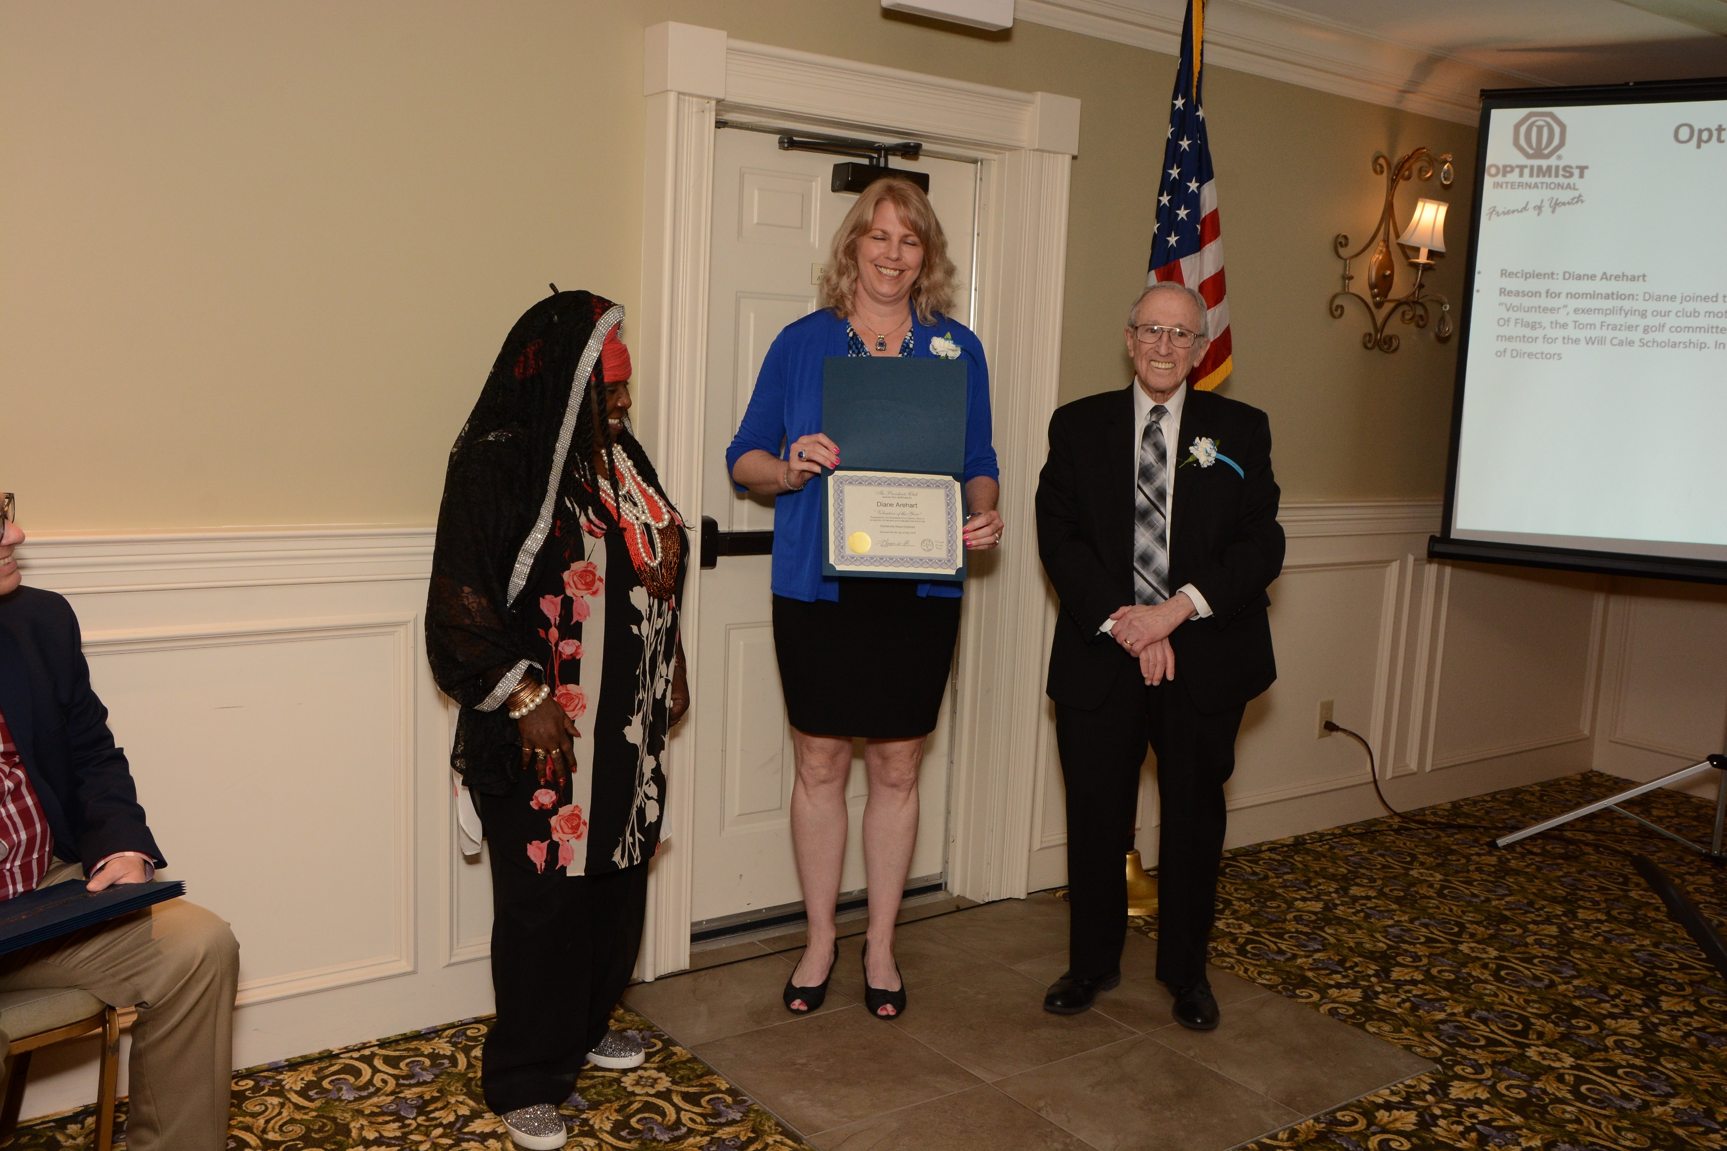
Optimist - Centerville Noon Club
Recipient: Diane Arehart
Reason for nomination: Diane joined the club in 2016 and has become a very active and hands on “Volunteer”, exemplifying our club motto of “Friend of Youth”. Diane is a volunteer for the Avenue Of Flags, the Tom Frazier golf committee, Build a Bear, and many other events. Diane is also a mentor for the Will Cale Scholarship. In addition to her volunteering, she also serves on the Board of Directors

Slide 17

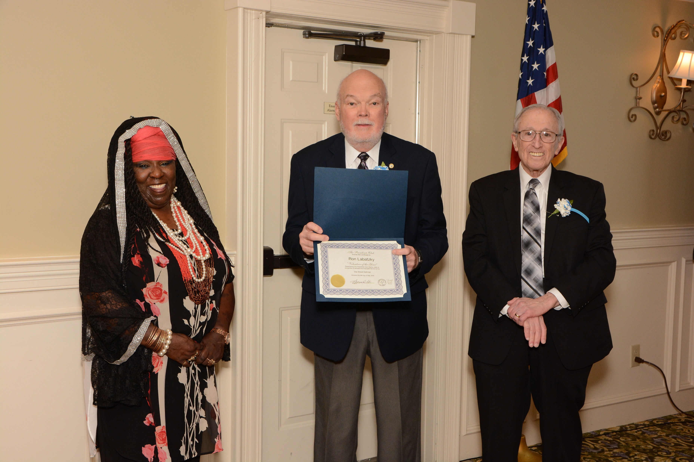
Optimist – Dor-Wood Club
Recipient: Ron Labatzky
Reason for nomination: Ron has been a member of Dor-Wood since 2011. Ron heads up the Youth Fishing Derby that is sponsored by Dor-Wood + Kettering City Police. Ron also heads up the Optimist Kids Day in the Park. The Kids Day Project was Optimist District winner in Community Project. Last year, Ron won the District Humanitarian award for his outstanding continuation to Optimism and Humanity in our club and community.

Slide 18
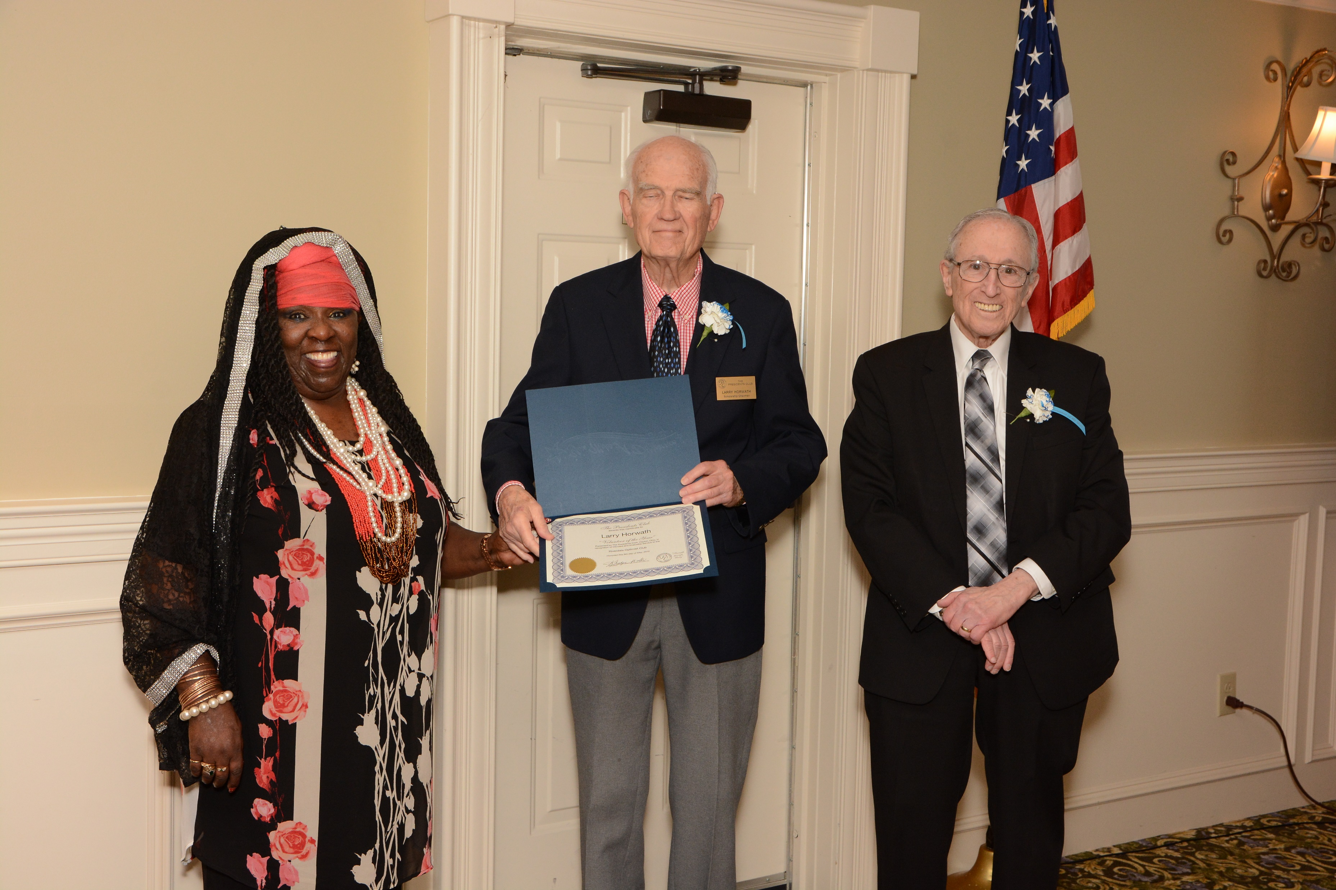
Optimist - Riverdale Club
Recipient: Larry Horwath
Reason for nomination: Larry joined the Riverdale Optimist Club in February, 1982. He was President in 1987-88, and then Lt. Governor for our Zone in 1988-89. Larry has been active involved in the Miami Valley Boy Scouts and recently was awarded a medal for his 50 years of service to that organization. Larry is also on the Board of The Presidents Club of Dayton and has been instrumental since 1991 for soliciting funds for the Sinclair scholarships that the Presidents Club awards at the Legion of Honor. Originally, member clubs contributed. For the past 15 plus years, the Legion event has helped to grow and add to the scholarships.

Slide 19
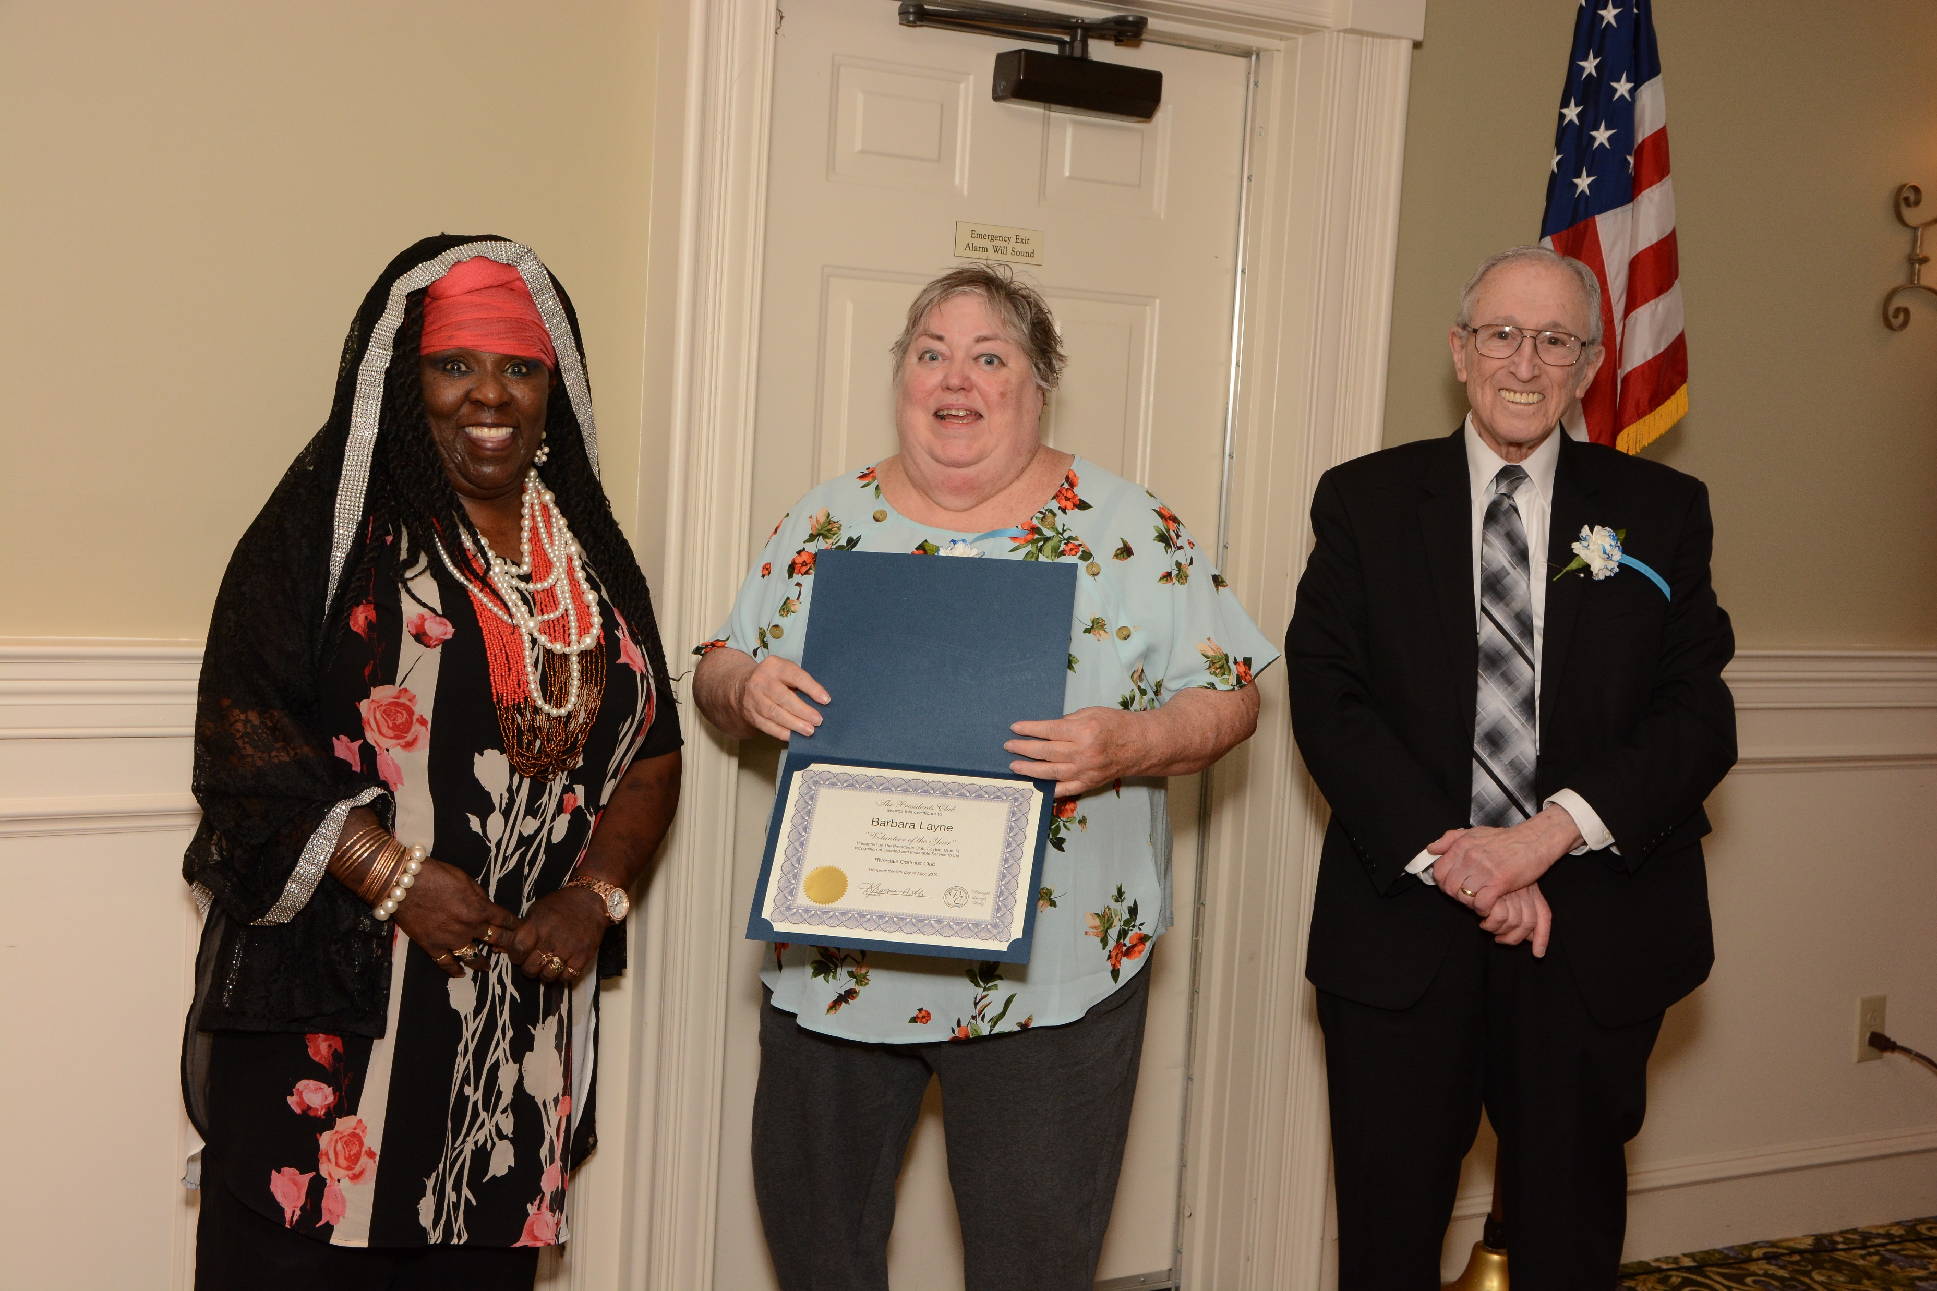
Optimist - Riverdale Club
Recipient: Barbara Layne
Reason for nomination: Barbara was one of the first women in the Ohio District Optimist International to join the organization in October,1987. She has maintained perfect attendance since joining. Riverdale meets weekly! She was asked to publish the weekly bulletin in 1988 and did so for 8 years, earning two first place wins in the Ohio District and one third place win in Optimist International. She was voted on to the Board of Directors in 1988 and then appointed Secretary in 1991, a position she has held since that time except for the year she was President (1994-1995). In 1996 she was elected to be a Zone Lt Governor for the Ohio District and held that position for many years. In 1991, Barbara was elected Governor Elect, and assumed the Governorship in 2000-2001. She has been very active on the District level in many positions including Leadership Development, Chaplain, Hospitality, etc. Barbara has also taught two classes at the International Convention and is has a Certification for Club/Zone, District, and International levels. She was recently appointed to the position of Ohio District Secretary and will assume that role on October 1. Barbara has also be the organizer of Optimist Night at the Dayton Dragons and this year will be her 20th year. In 1996, Barbara was asked to be the Treasurer of the Presidents Club of Dayton, a position she held until 2009. For the past several years she has acted as the Secretary.

Slide 20

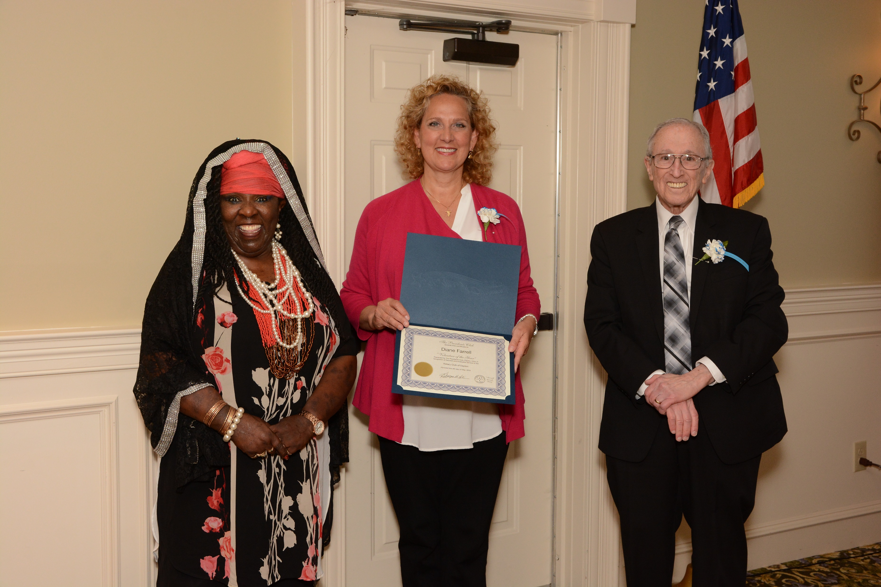
Rotary Club of Dayton
Recipient: Diane Farrell
Reason for nomination: Diane is Director, Development and External Relations for the Dayton Metro Library. As Chair of the Membership Recruitment Committee for the Rotary Club of Dayton, Diane was instrumental in leading her committee of Rotarian volunteers to hold a "first ever" "Bring a Guest" Day at a weekly Rotary Luncheon in November of last year. This event brought in 56 guests (prospective members) to our lunch to introduce them to our Club with the possibility of having them join. A significant level of planning was required along with coordinating all aspects of this memorable event. Diane continues to be an outstanding Rotarian and volunteer in her role as Chair of the Membership Recruitment Committee.

Slide 21
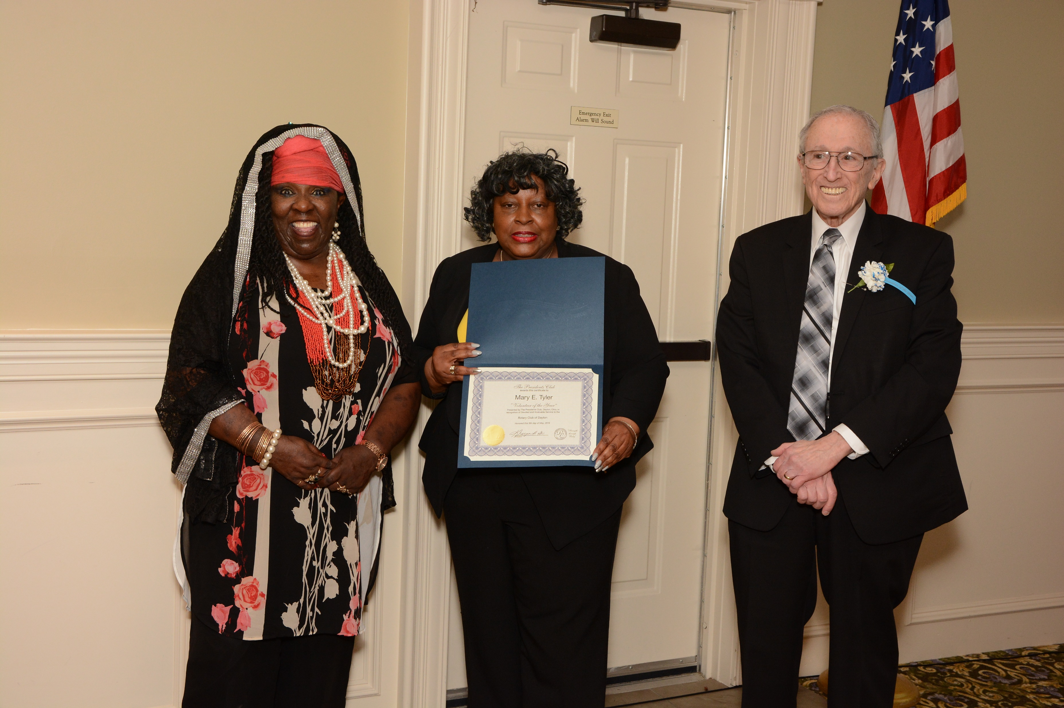
Rotary Club of Dayton
Recipient: Mary E. Tyler
Reason for nomination: Mary is Executive Director for The National Conference for Community and Justice of Greater Dayton. As Chair of the 4-Way Speech Contest for the Rotary Club of Dayton, Mary directed and led a team of Rotarian volunteers to conduct our annual 4-Way Test Speech contest for high school students designed to foster ethics in their everyday life. This past year was the second year for this event that Mary led. She worked diligently to plan, organize and implement a very successful "modified" program that led to a student being selected to represent our Club at the District level. She had to coordinate with several other Club committees to ensure the program was a success. Mary always conducts her activities with a smile and is an active volunteer within our Club.

Slide 22

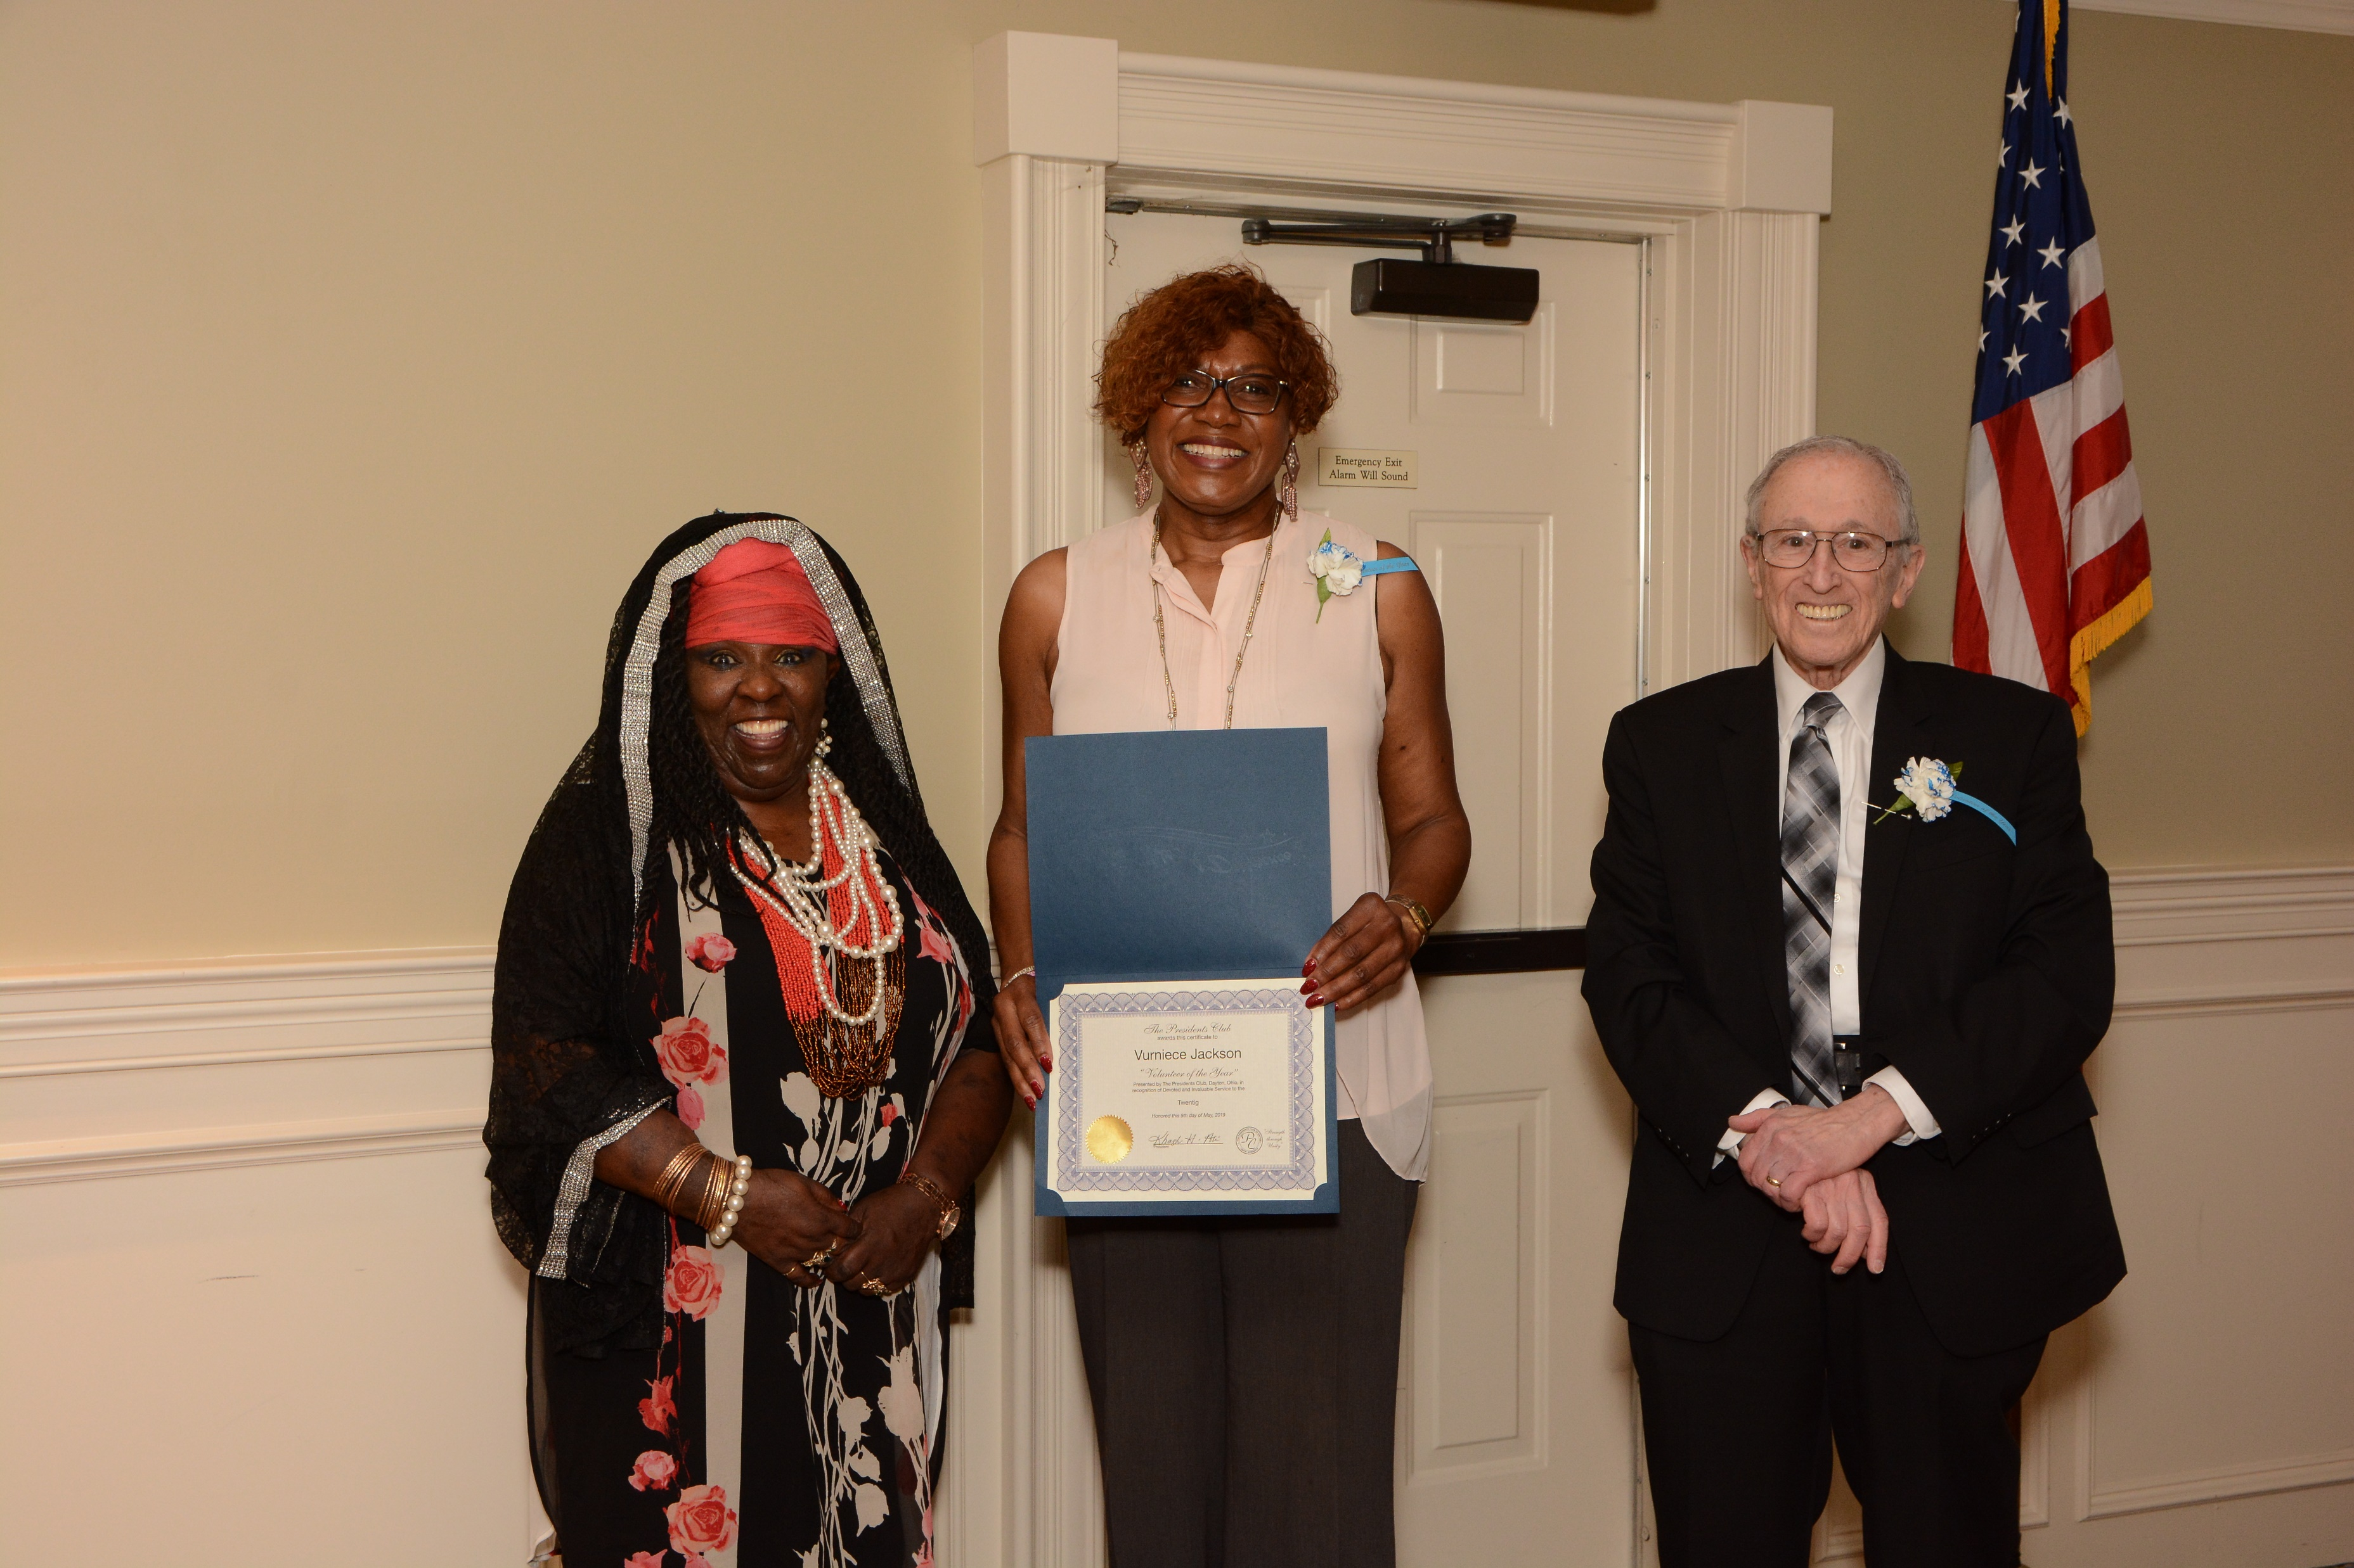
Twentig, Incorporated
Recipient: Vurniece Jackson
Reason for Nomination. Vurniece is first and foremost a gracious woman of God. Her attitude of gratitude is present in all that she does and say. She patient, kind, considerate and is always ready to lend a helping hand. Vurniece is the epitome of a impactful Servant Leader. She believes her unselfishness and compassion for others changes lives for the better. As a Servant Leader she focuses on the thriving of her community. She contributes countless hours of her time volunteering for such organizations as the Diabetes Association, MLK Dayton, Inc, and the Salvation Army Kroc Center to name a few. Vurniece possesses exceptional leadership and organizational skills. Her love for humanity has made a positive impact in all she does and the lives she touches.

Slide 23
Presidents Club Schedule
The Bob Chiles Golf Classic May 10th, 2019 and location
Monthly Lunches at the Masonic Temple Lower Level 11:30 AM
May 15th
June 19th
July 17th
August 21st
September 18th
October 16th
November 20th
December 18th
The Citizens Legion of Honor Award October 3rd, 2019 at the Dayton Convention Center

